Slide 1
Experimental Design and Statistics
Conor Meehan (he/they)
conor.meehan@ntu.ac.uk
@con_meehan

Slide 2
Learning outcomes
Compare different types of research design
Identify various research variable types
Implement different types of descriptive statistics
Identify appropriate sample types
Explain the statistical assumptions and how to test each one
Utilise inferential statistics flowcharts to select the appropriate test for your experiment

Slide 3
Research types
Many ways to answer a research question
  Design of the experiment influences the answers you can obtain
Various definitions of research
  Qualitative vs quantitative
  Cross sectional vs longitudinal
  Experiment vs correlation

Slide 4
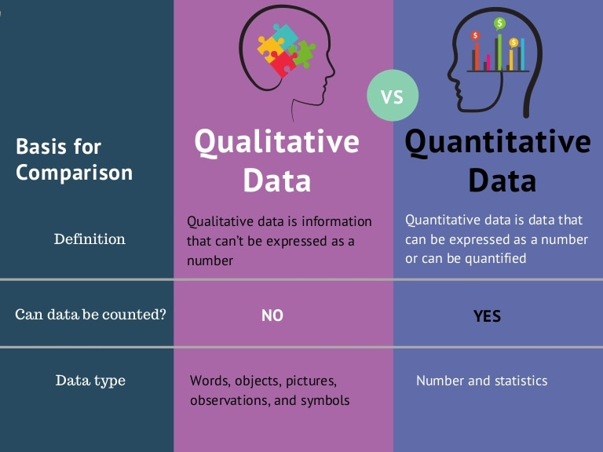
Qualitative vs quantitative
https://www.slideshare.net/Intellspot/qualitative-vs-quantitative-data-infographic

Slide 5
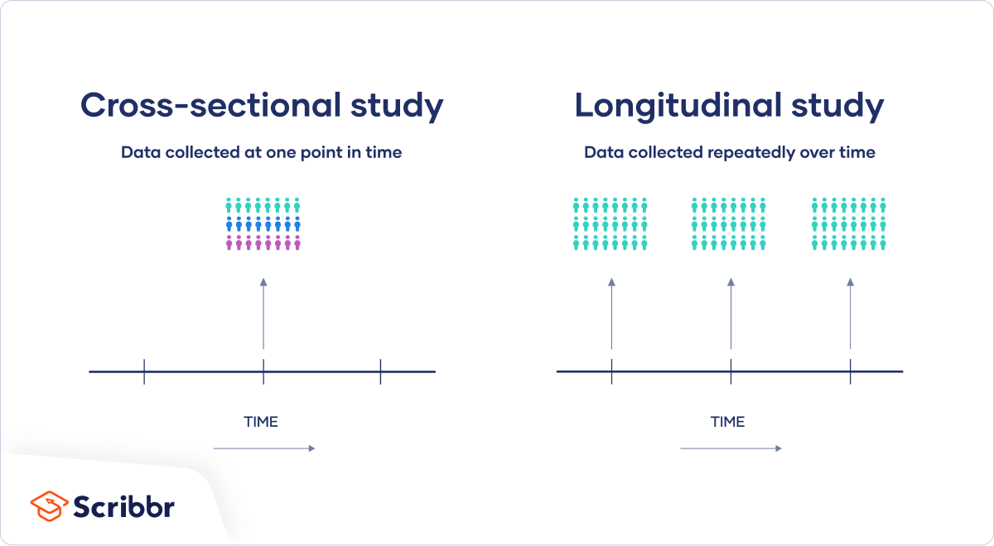
Cross sectional vs longitudinal
https://www.scribbr.com/methodology/cross-sectional-study/

Slide 6
Experiment vs correlation
 | Correlational research | Experimental research
Purpose | Used to test strength of association between variables | Used to test cause-and-effect relationships between variables
Variables | Variables are only observed with no manipulation or intervention by researchers | An independent variable is manipulated, and a dependent variable is observed
Control | Limited control is used, so other variables may play a role in the relationship | Extraneous variables are controlled so that they can’t impact your variables of interest
Validity | High external validity: you can confidently generalize your conclusions to other populations or settings | High internal validity: you can confidently draw conclusions about causation
https://www.scribbr.com/methodology/correlational-research/

Slide 7
What type of research?
Qualitative vs quantitative
A survey of mask wearing habits in a student population
Assessing the impact of low GI diets on insulin production
Cross sectional vs longitudinal
The number of new cases of coronavirus globally on a single day?
The change in vaccination rates between January and December 2021

Slide 8
What type of research?
Experiment vs correlation
The relationship between the amount of glucose and level of insulin in the local population
The amount of insulin produced by mice based on a defined range of glucose intake
The impact of a plasmid presence/absence on tetracycline resistance in E. coli
The presence of a plasmid in bacterial strains sensitive or resistant to tetracycline

Slide 9
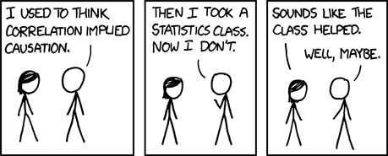
Correlation does not equal causation
100% of people who wear socks die
A correlation needs more experimental proof to determine causation
https://xkcd.com/552/

Slide 10
Variable types
An attribute of the study
What is the data?
  Number of samples
  Age of patient
  Growth yes/no
What part of the experiment is this variable in?
  Input data
  Output data
  Control
  Technical/biological replicate

Slide 11
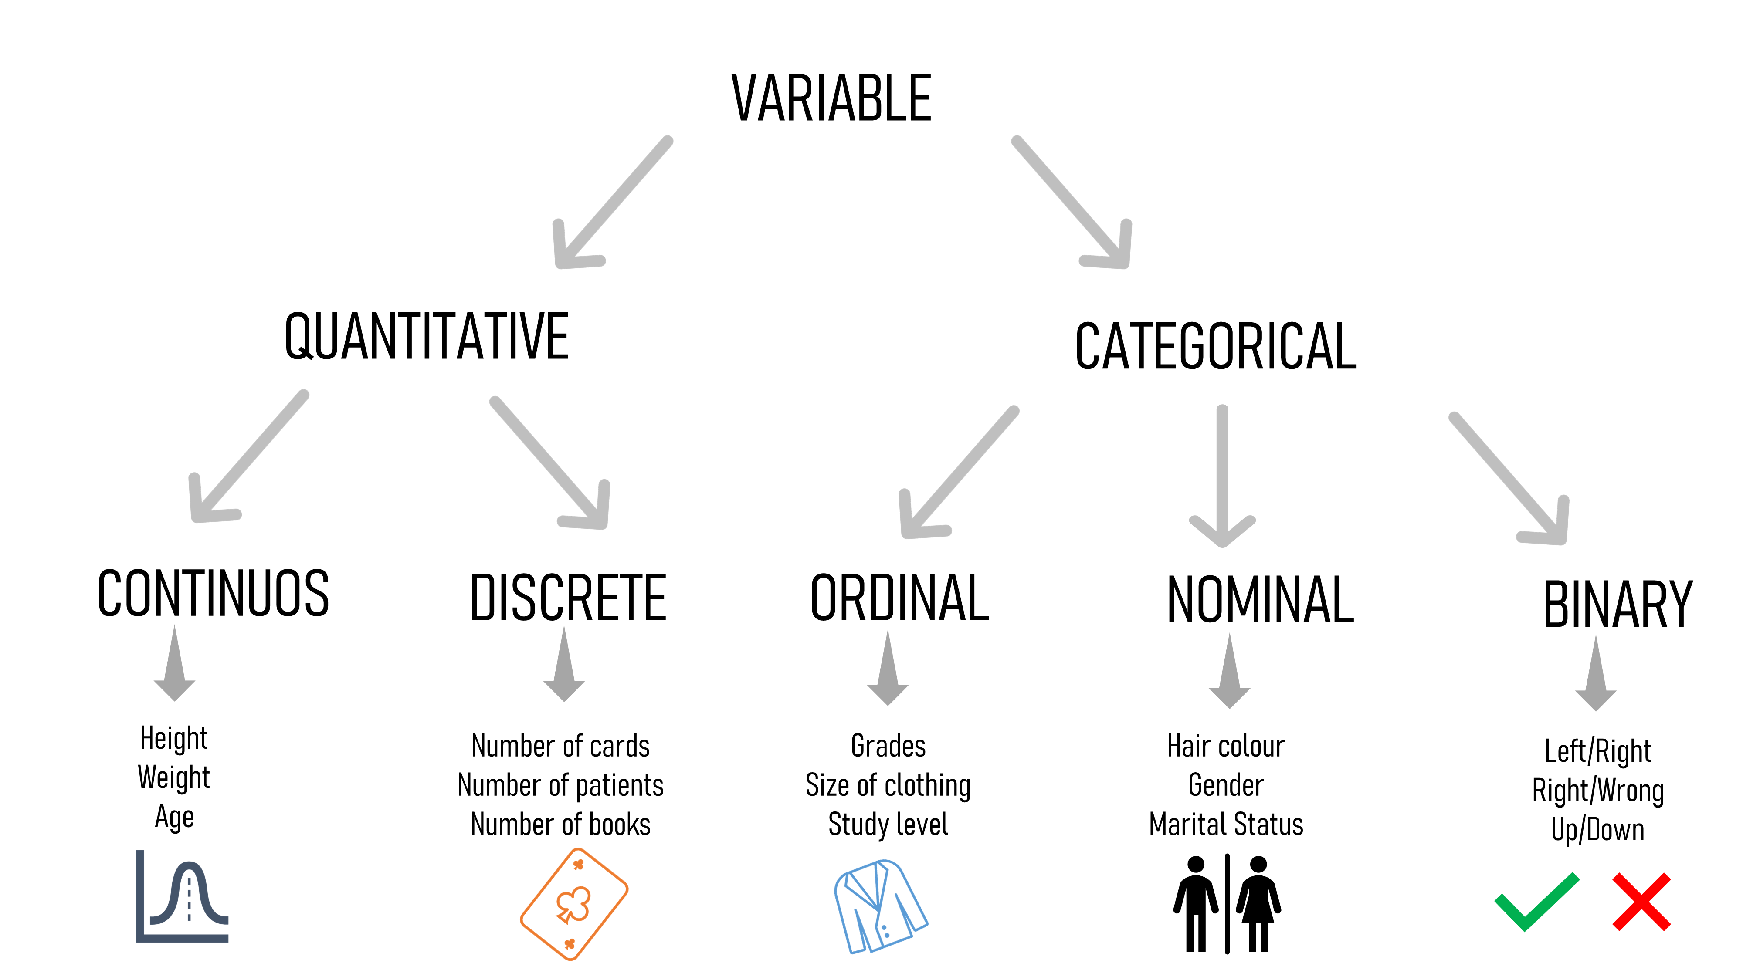
Variable types
https://towardsdatascience.com/statistical-testing-understanding-how-to-select-the-best-test-for-your-data-52141c305168

Slide 12
Quantitative data
Amounts of things
Continuous
  Also called Ratio
  Measurements of potentially infinite values
  E.g. MIC, age, amount of glucose produced/consumed
Discrete
  Also called Interval
  Counts
  Cannot be divided less than 1
  Number of patients, cell count

Slide 13
Categorical data
Groups of things
Ordinal
  Rankings
    Something with an order
  E.g. Disease stage, BMI category
Nominal
  Names
  E.g. species counts, blood group, symptoms
Binary
  Yes/No
  E.g. symptom present/absent, alive/dead

Slide 14
Which type?
Number of white blood cells in a sample
Presence of inflammation
Sodium consumption split into low/medium/high
Gram stain result

Slide 15
Variables in an experiment
Experiment is trying to find out effect of one variable on another
  Level of antibiotic on bacterial growth rate
  BMI category on diabetes occurrence
Independent
  Predictor variable
    Cause
  What you manipulated in the experiment
Dependent
  Outcome variable
    Effect
  What was measured in or resulting from the experiment
Control
  Constants during the experiment

Slide 16
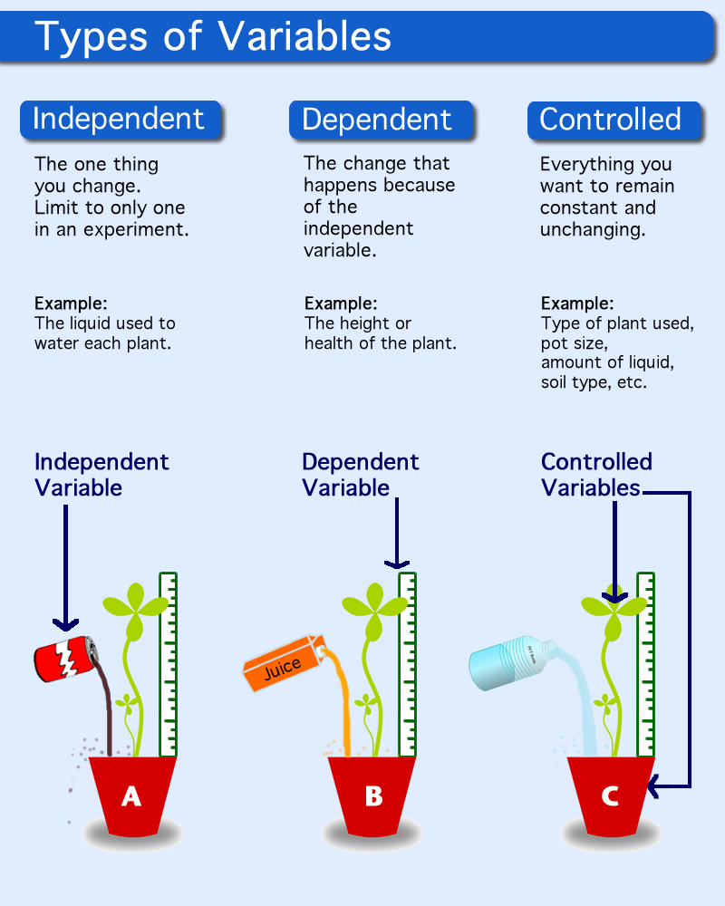
Variables in an experiment
http://edtech2.boisestate.edu/angelacovil/506/procedure.html

Slide 17
Which type?
Independent, dependent or control?
The number of cells left after disinfecting
The constant temperature throughout the experiment
The amount of glucose added to the petri dish

Slide 18
Correlation variables
Looking for association, not cause and effect
Predictor
  Variable that comes first
    Glucose level
Outcome
  Variable that comes afterwards
    Insulin level

Slide 19
Questions and break

Slide 20
Summary statistics
Also called descriptive statistics
Not testing a hypothesis, just describing/summarising the data
  Cannot infer anything about larger population
3 main types
  Distribution
  Central tendency
  Variability
Can apply to
  1 variable: univariate analysis
  2 variables: bivariate analysis
  3 or more variables: multivariate analysis

Slide 21
Frequency distribution
Ages of participants:
18, 19, 21, 20, 17, 18, 16, 16, 21, 18
Simple table
Grouped table
Age | Number
16 | 2
17 | 1
18 | 3
19 | 1
20 | 1
21 | 2
Age | Number
16-17 | 30%
18-19 | 40%
20-21 | 30%

Slide 22
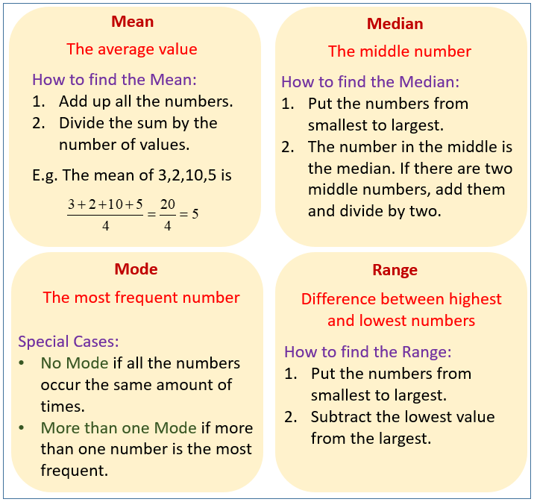
Central tendency
Estimate the average or centre of a dataset
https://www.onlinemathlearning.com/mode-mean-median.html

Slide 23
Variability
How spread out is the data?
Range:
  What is the difference between the minimum and maximum values?
  Max – min = range
Standard deviation:
  On average, how far is each point from the mean?
Variance:
  The amount of spread in the data
  Square the standard deviation

Slide 24
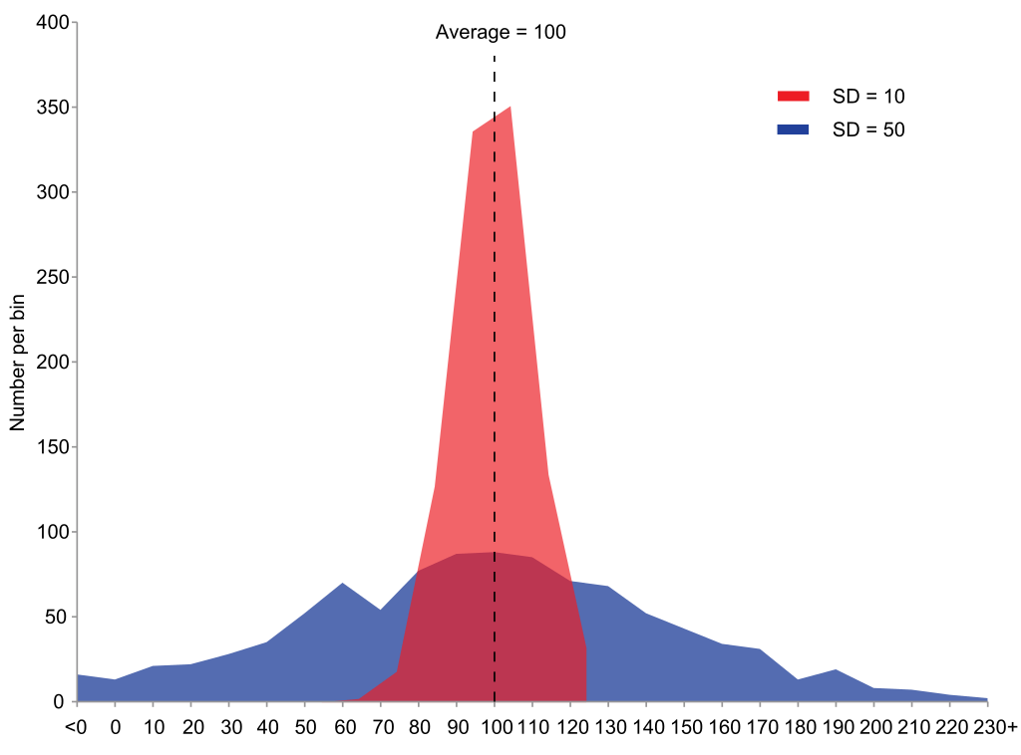
Variability
Wikipedia

Slide 25
Bivariate/Multivariate analysis
Compare descriptive statistics between 2 or more groups
Contingency tables
  Intersection between 2 variables
  Can be input for inferential statistics
Species A
 | Present | Absent | Total
Present | 15 | 3 | 18
Absent | 20 | 10 | 30
Total | 35 | 13 | 48
Species B

Slide 26
Collecting samples
The samples you use must allow you to test your hypothesis
They must be:
  Appropriate
    Related to the hypothesis and measurable
  Representative
    Randomly chosen or specific characteristics?
  Sufficient sample size
    More variable populations need larger sample sizes

Slide 27
Sample types
Independent
  Observations in one data point do not influence those in another datapoint
  Single observation from a sample
  Comparing groups that are separate from each other
  E.g. One set of patients takes diet 1 and another takes diet 2
Paired
  Observations in one data point are influenced by those in another datapoint
  Multiple observations from the same sample
  Comparing same group in different conditions
  E.g. Same patients take diet 1 and then take diet 2

Slide 28
Which type?
2 different growth conditions on the same set of bacterial strains
Mice in litter A given drug 1 and mice in litter B given drug 2
Difference in glucose levels in the morning and in the evening in a patient
qPCR expression data is compared between clinical samples and a negative control sample
5 patient samples treated separately with a negative control and a drug

Slide 29
Controls and replicates
Controls:
  Same conditions but no change in variable
  Negative/positive control
    Known outcome
Replicates
  Can’t control for every variable
  Use replicates to try buffer out other variables
    Small differences in temperature between days
    Slightly different handling abilities
    Different ‘identical’ cells might behave slightly differently
  Grubbs test for outliers can then be used to remove bad replicates

Slide 30
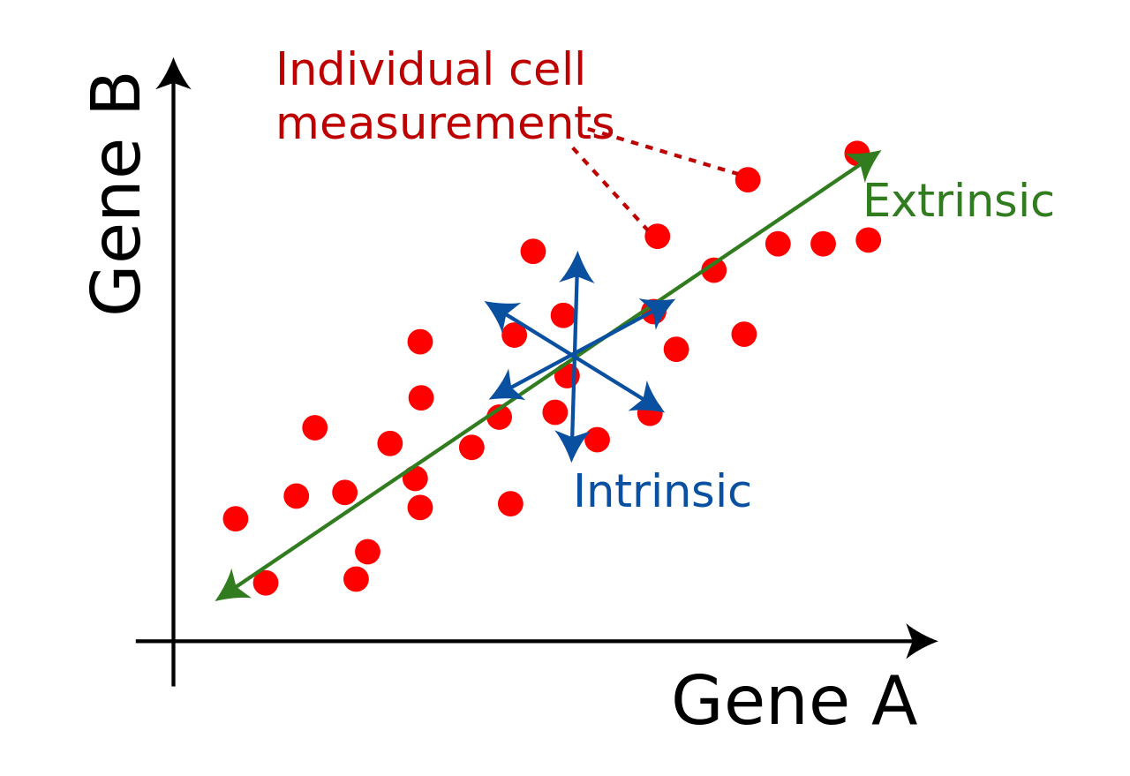
Data Variability
When we see a difference between populations, is it true or an error or noise?
Error:
  Machine fluctuation
  Technician fluctuation
Noise:
  Stochastic effects
  Extrinsic
  Intrinsic
Wikipedia.org

Slide 31
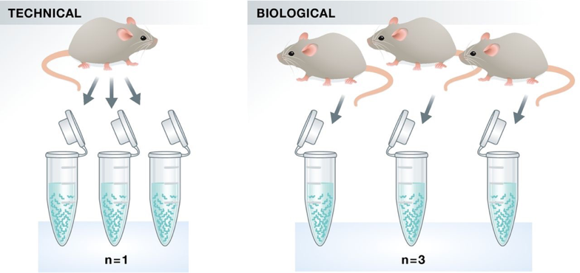
Technical and biological replicates
Technical:
  Same sample, multiple runs
Biological
  Different ‘identical’ samples
https://hbctraining.github.io/Intro-to-rnaseq-hpc-salmon/lessons/experimental_planning_considerations.html

Slide 32
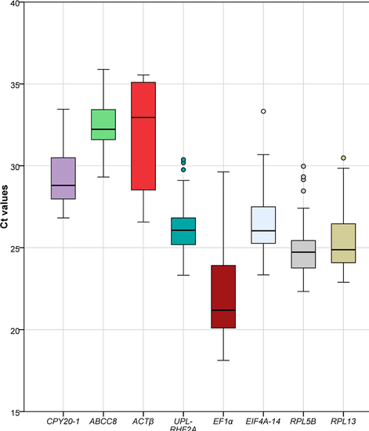
Replicates and outliers
Liang et al Sci Rep 2020

Slide 33
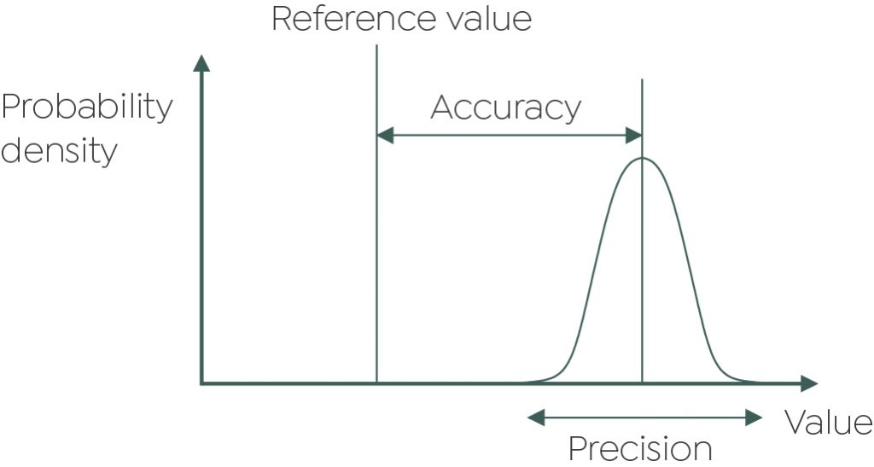
Accuracy and precision
Accuracy: how alike are your measurements to the true value?
Precision: how alike are your measurements to each other?
Replicates should be accurate and precise
  Good lab practice
https://grantinstruments.com/measurement-accuracy-and-precision-of-data

Slide 34
Questions and break

Slide 35
Inferential statistics
Using a statistical test to infer a significant relationship
Usually involves a p-value
2 types of inferential statistics:
  Parametric
  Non-parametric
Need to test for statistical assumptions before selecting a type

Slide 36
Statistical assumptions
Parametric tests make specific assumptions about data
Independence of observations
  Experimental design
Homogeneity of variance
  Levene’s or Bartlet’s test
Normality of data
  Shapiro-Wilk test
If any are violated, use a non-parametric test

Slide 37
Independence of observations
The measurement of one sample is not influenced by the measurement of another sample
Part of experimental design
Example violations:
  Including technical/biological replicates as separate samples
    Get average and include 1 data point
  Identical control/treatment conditions
    Must be a change to be measured
  Multiple entries of the same sample/person
    Single datapoint per sample

Slide 38
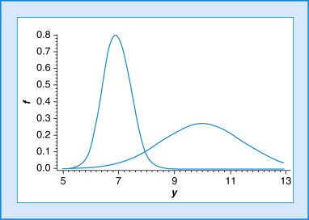
Homogeneity of variance
Is the variance in dataset A similar to the variance in dataset B?
Bartletts test or Levene’s test
  If significant, then need to use non-parametric test

Slide 39
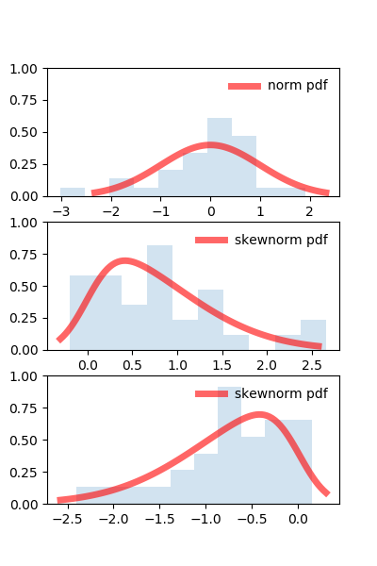
Normality of data
Does the data follow a normal distribution?
Shapiro-Wilk test
  If significant, then need to use non-parametric test
https://scientificallysound.org/2018/06/21/test-normal-distribution-r-part-3/

Slide 40
Selecting the right inferential statistic
Parametric or non-parametric?
Paired or independent samples?
What’s the independent/predictor variable
What’s the dependent/outcome variable?

Slide 41
Parametric tests flowchart

Slide 42
Categorical predictor variable parametric tests flowchart

Slide 43
Select the right test
Do 3 different drugs each have the same or different effects on insulin levels in mice (different mice tested for each drug)?

Slide 44
Select the right test
Is there a difference in cell size at the start and end of a 12-hour period of treatment?

Slide 45
Non-parametric tests flowchart

Slide 46
Post-hoc testing
ANOVA only tells you there is significance in the data
  Doesn’t say which groups are significantly different
When there are more than 2 groups, a further test is needed
  Cannot just use t-tests as experimental error increases

Slide 47
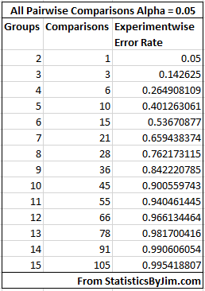
Experimental error
Any statistical test has a chance of producing a false positive
  Type I error (experimental error)
Single tests counteract this with the significance value
  Significance value = Type 1 error rate
  0.05 means 5% chance of false positive
Every additional test increases the type I error
  Cant just continually do t-tests
Comparisons of multiple groups must correct for this
https://statisticsbyjim.com/anova/post-hoc-tests-anova/

Slide 48
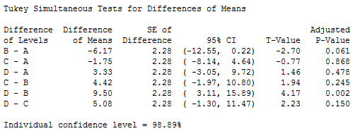
Post-hoc testing
ANOVA only tells you there is significance in the data
  Doesn’t say which groups are significantly different
When there are more than 2 groups, a further test is needed
  Cannot just use t-tests as experimental error increases
Post-hoc tests are performed to look within the dataset and compare the groups
  All vs all: Tukeys method
  All vs control: Dunnett’s method
  Find the best: Hsu’s MCB
https://statisticsbyjim.com/anova/post-hoc-tests-anova/

Slide 49
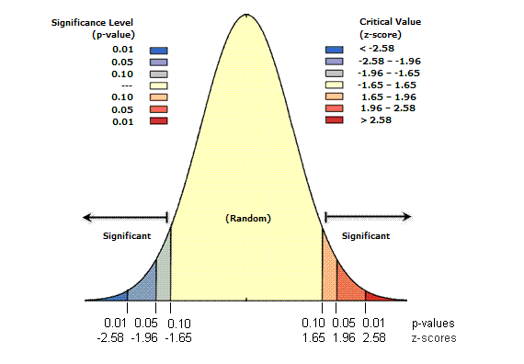
Interpreting a statistical result
Most tests will produce a p-value
  Probability that this result is observed under the null hypothesis
Small p-values mean unlikely result is observed under H₀
  Can reject H₀
    Still need to prove H_{a} is correct
P-value <0.05
  95% probability H₀ is false
https://pro.arcgis.com/en/pro-app/latest/tool-reference/spatial-statistics/what-is-a-z-score-what-is-a-p-value.htm

Slide 50
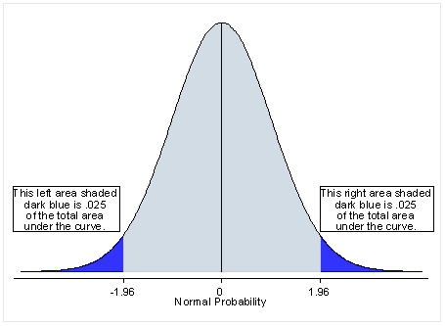
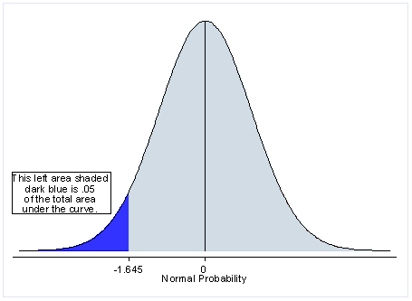
One-tailed vs two-tailed tests
A p-value is testing the presence of your data in the extremes of the distribution
2 tailed test splits it evenly between the 2 tails
  0.025 on the right, 0.025 on the left
1 tailed test disregards one side in favour of more power on the other
Can only use 1 tailed test if sure that the other direction is extremely unlikely
  Cannot use to boost significance in one direction
https://hbctraining.github.io/Intro-to-rnaseq-hpc-salmon/lessons/experimental_planning_considerations.html

Slide 51
Learning outcomes
Compare different types of research design
Identify various research variable types
Implement different types of descriptive statistics
Identify appropriate sample types
Explain the statistical assumptions and how to test each one
Utilise inferential statistics flowcharts to select the appropriate test for your experiment

