Slide 1
An Introduction To Phylodynamics
Conor Meehan (he/they)
conor.meehan@ntu.ac.uk
@con_meehan

Slide 2
Learning outcomes
Recognise the Monte Carlo Markov Chain process
Describe some common Bayesian epidemiology priors
State the molecular clock hypothesis
Describe the coalescent and its use for estimating population dynamics
Identify the origins of a new pathogen using phylogenetics
Recognise the approaches used to determine transmission dynamics of pathogens

Slide 3
How to read a WGS phylogenetics methods section
      Four decades of transmission of a multidrug-resistant Mycobacterium tuberculosis outbreak strain Eldholm et al. Nature Communications (2015)
      In BEAST, rates were modelled using the GTR substitution model of evolution and variation among sites was simulated using a discrete gamma distribution with four rate categories. We further assumed a lognormal relaxed clock to allow variation in rates among branches in the tree. The tree was calibrated using tip dates only with sample time span ranging from October 1996 to December 2009.
      For each analysis we ran four independent chains in which samples were drawn every 5,000 MCMC steps from a total of 50,000,000 steps, after a discarded burn-in of 5,000,000 steps.
      Yellow sections covered in optional models of evolution lecture
      Blue sections explained here

Slide 4
Parametric methods of phylogenetic inference
Parametric methods take a column in an alignment and calculate the optimality criterion per site
  Sites are independent
  An explicit model of evolution is required
  Can incorporate rate heterogeneity
There are two main parametric methods of phylogenetic inference:
  Maximum likelihood
  Bayesian analysis
Both methods search tree space to find the best tree

Slide 5
Bayesian analysis
Often used to build time trees where branch lengths correspond to a certain length of time
Can give estimate of tree phylogeny and other parameters
  Divergence date/location
  Rate of speciation/extinction
Incorporates existing knowledge into the data (priors)
Gives a posterior probability that the hypothesised tree is true, given the observed data and priors
  Posterior probabilities serve as reliability measure
Example programs: BEAST/BEAST2, MrBayes/RevBayes, PhyloBayes

Slide 6
Bayesian analysis (MCMC)
Each cycle is a step in a Monte Carlo Markov Chain (MCMC)
Must assess for convergence to see if the cycles are finding the same answer repeatedly and thus can be stopped
  See worksheets
The tree topology and parameters that were visited the most (i.e. present in the most states) are output as the optimal phylogeny etc.
The posterior probablity is the proportion of cycles that branch was found in (between 0 and 1)

Slide 7
Bayesian priors
If we have prior knowledge that applies to the data, we can incorporate this into the model
  Sampling dates
  Model of evolution
  Fossil dates
For instance we may have a dataset of an outbreak that started in 2009 and we can limit the estimates of transmission dates on a tree to be >2009
These help guide the process through tree searching space
  Wrong priors give wrong estimates
Can/Must also incorporate evolutionary/population processes into the model
  Time trees requires a molecular clock model
  Population size estimates require a population model
  Can also test which is appropriate within the framework

Slide 8
Tasks 1
What can Bayesian analyses estimate that other methods such as ML cannot?
What does the posterior probability represent?
Give an example of a prior you may input for molecular epidemiology analyses.

Slide 9
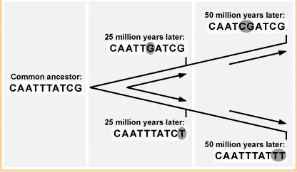
Molecular clock
Assumed that there is a stocastic relationship between time and the rate of mutation of a gene
If we know this rate, we can correlate it to changes through time and estimate a divergence time
http://evolution.berkeley.edu/evosite/evo101/IIE1cMolecularclocks.shtml

Slide 10
Strict versus Relaxed
Strict:
  One rate of mutation for every branch in tree
Relaxed
  Different rate for each branch
  Correlated:
    Rates influenced by the rate of the parent branch
  Uncorrelated
    Rates independent
R₁
R₁
R₁
R₁
R₁
R₁
R₁
R₁
R₅
R₃
R₆
R₂
R₇
R₄
R₈
R₁

Slide 11
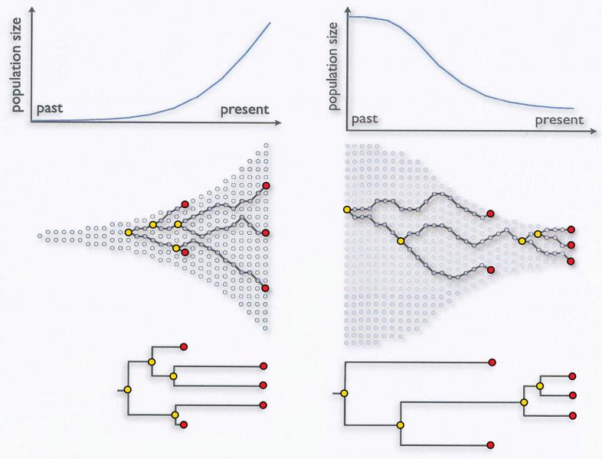
Coalescent
A model of population evolution
When two alleles/individuals come together to form an ancestor (i.e. two branches meet) this is called a coalescent event
Sainani Biomedical computation review (2009)

Slide 12
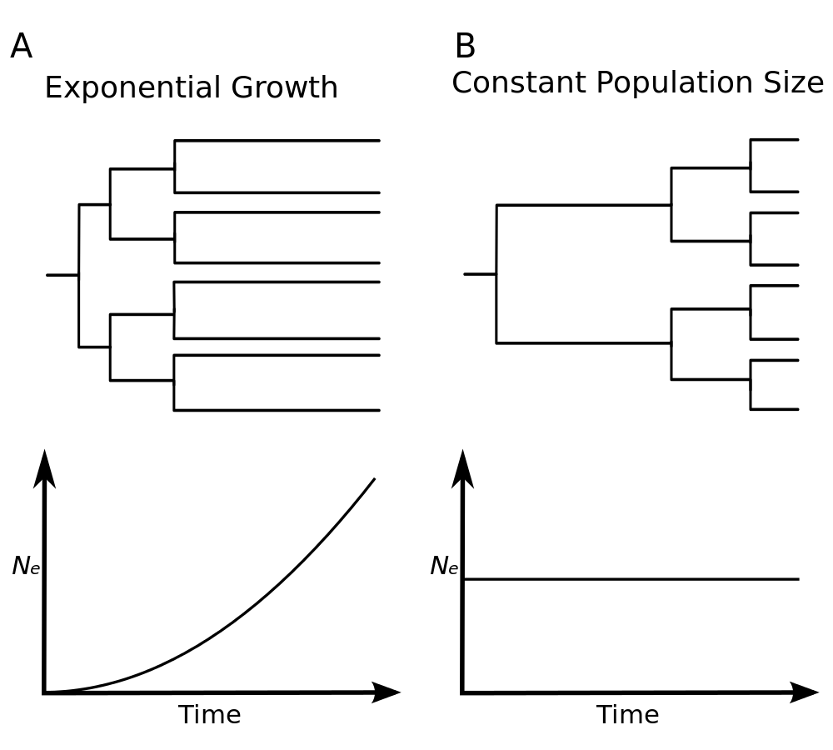
Coalescent
Exponential:
  Suitable for early samples
Constant:
  Population is stable from MRCA to current time
Volz et al. PLoS comp bio (2008)

Slide 13
Estimating population changes
Population sizes can be estimated from phylogenetic data
Split time tree into intervals between coalescent events
Population size calculation
  N_{i} = γi(i-1)/2
  γ is the interval length
  i is number of lineages in interval
Bayesian skyline plot
  Estimates phylogeny and population size simultaneously
  Also done in Skyride and Skygrid
Ho & Shapiro, Mol Ecol Res 2011

Slide 14
How to read a WGS phylogenetics methods section
      Four decades of transmission of a multidrug-resistant Mycobacterium tuberculosis outbreak strain Eldholm et al. Nature Communications (2015)
      In BEAST, rates were modelled using the GTR substitution model of evolution and variation among sites was simulated using a discrete gamma distribution with four rate categories. We further assumed a lognormal relaxed clock to allow variation in rates among branches in the tree. The tree was calibrated using tip dates only with sample time span ranging from October 1996 to December 2009.
      For each analysis we ran four independent chains in which samples were drawn every 5,000 MCMC steps from a total of 50,000,000 steps, after a discarded burn-in of 5,000,000 steps.
      Yellow sections covered in optional models of evolution lecture
      Blue sections explained here

Slide 15
Tasks 2
What are the two main types of molecular clock?
What is a coalescent event?

Slide 16
Break

Slide 17
Determining the origin

Slide 18
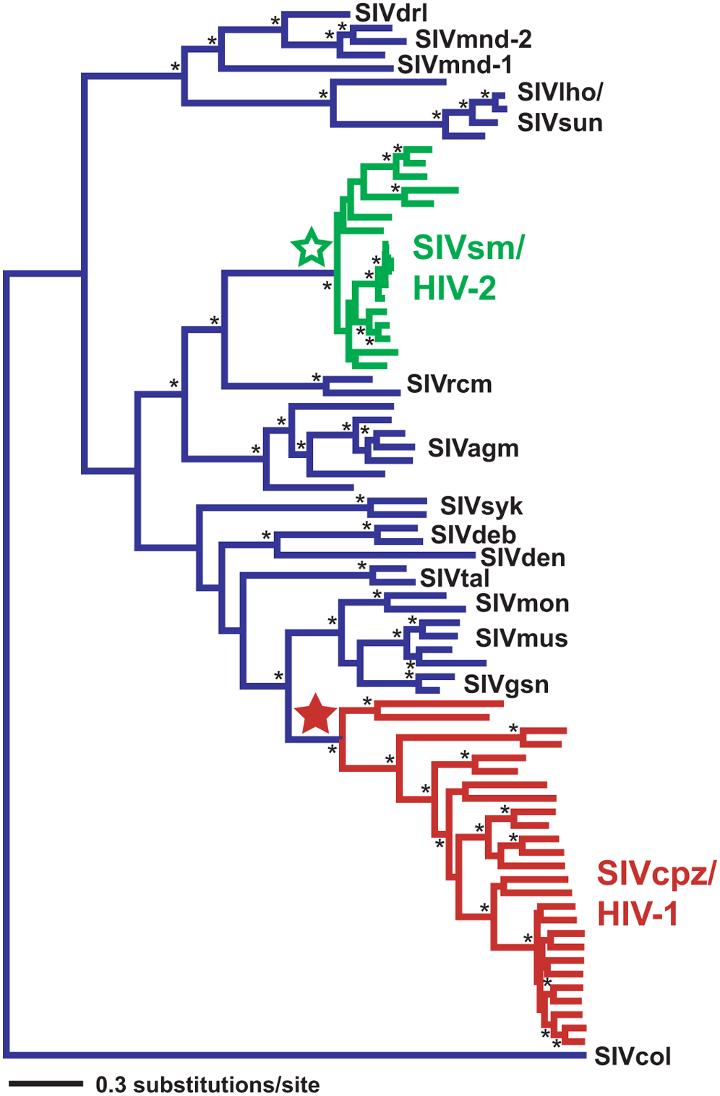
Where did HIV come from?
Lentiviruses are known to infect several species of primates in sub-Saharan Africa
Tree constructed containing sequences from SIV and both HIV-1 and HIV-2
HIV-1 likely arose in western equatorial Africa
HIV-2 likely arose in West Africa
  Primarily confined there too
Wertheim and Worobey, PLOS Comp Bio 2009

Slide 19
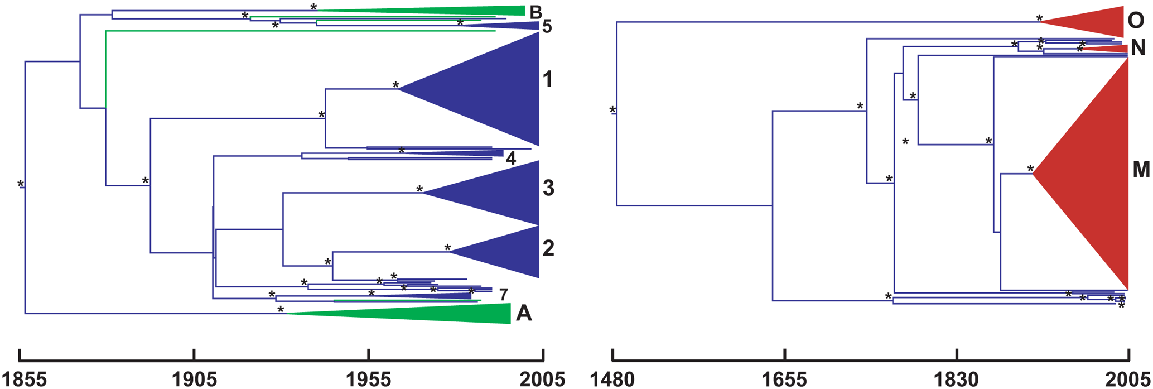
When did HIV get to humans?
Early estimations of HIV-1 divergence from SIVcpz dated this event as ~1960 (Li et al 1988, Mol. Biol. Evol.)
Reanalysis found that this estimation used too simple a model of nucleotide sequence evolution
    HIV analysis usually estimated under the GTR or SRD06 model
Dates spread throughout early 20th century
Wertheim and Worobey, PLOS Comp Bio 2009

Slide 20
How did HIV get to humans?
An early hypothesis, outlined in ‘The River’ by Edward Hooper (1999) suggested a a contaminated oral polio vaccine (OPV) used in the 1950’s
The other leading hypothesis is that blood-to-blood transmission occurred from butchered primate meat to hunters
Molecular evidence was gathered by Sharp et al (2001, Phil. Trans. R. Soc. Lond. B) to review these claims
  OPV trial chimpanzees were not the same as those suggested to be resevoir for SIV
  The origins were dated as ~1931, not 1950’
Although the bush meat hypothesis cannot be directly proven, phylogenetic and molecular analysis lend strong support against the OPV hypothesis

Slide 21
Estimating historical dynamics

Slide 22
Hepatitis C
Cause of liver disease and cirrhosis
Caused by the Hepatitis C virus (HCV)
  130-200M infected worldwide
    ~700,000 deaths a year
  Blood to blood contact
    Unsterilized equipment

Slide 23
Hepatitis C
Hepatitis C virus (HCV) has a high prevalence in Egypt
Suggested this is due to unsterile injections during mass treatment with parenteral antischistosomal therapy from 1920s to 1980s
63 partial E1 gene sequences from 1993
  Suitable for coalescent analysis because:
  Geographically diverse
  Random sampling
  No obvious population subdivisions
  Ample phylogenetic information
  Independent estimate of model of evolution
Bayesian skyline population model applied
  Estimate population sizes back in time
Drummond et al. Mol Biol Evol 2005

Slide 24
Estimating local transmission dynamics

Slide 25
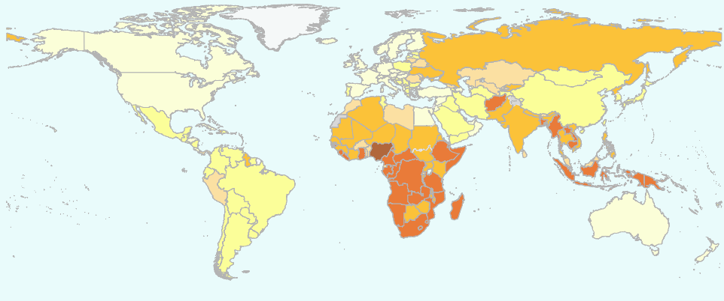
Mycobacterium tuberculosis
Causative agent of TB
  ~1/3 of the world (supposedly) infected
Transmitted by aerosols
  Close contact between people
  Long latency before active disease
Transmission important in drug resistance
  Transmission > point mutations
  Some multidrug resistant (MDR) strains circulating for decades

Slide 26
RR-TB in Rwanda
Rifampicin resistant tuberculosis
  Must be treated with second line drugs
  Large issue in clinical and public health management
308 whole genome samples of RR-TB in Rwanda
  1991-2018
What amount of RR-TB is due to transmission?

Slide 27
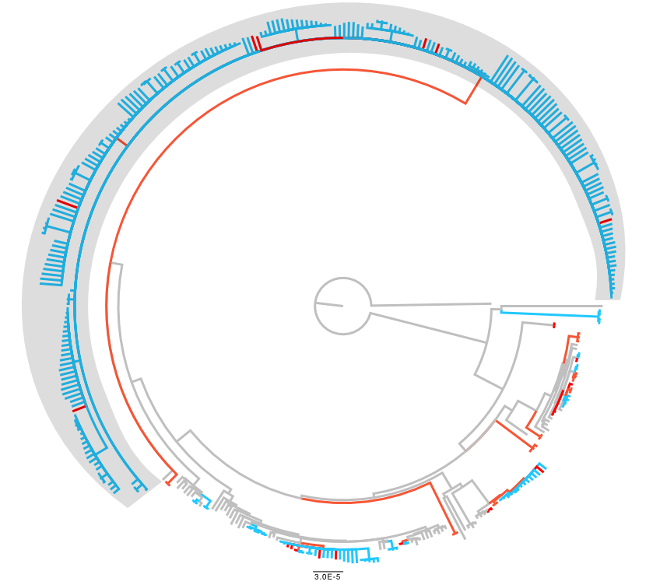
Rwanda RR-TB driven by a single transmission cluster
5 SNP transmission clusters in blue
  12 SNP clusters in red
One large transmission cluster (grey) driving RR-TB
  When did it arise?
  Who is transmitting?
Ngabonziza et al, JCTUBE, 2022

Slide 28
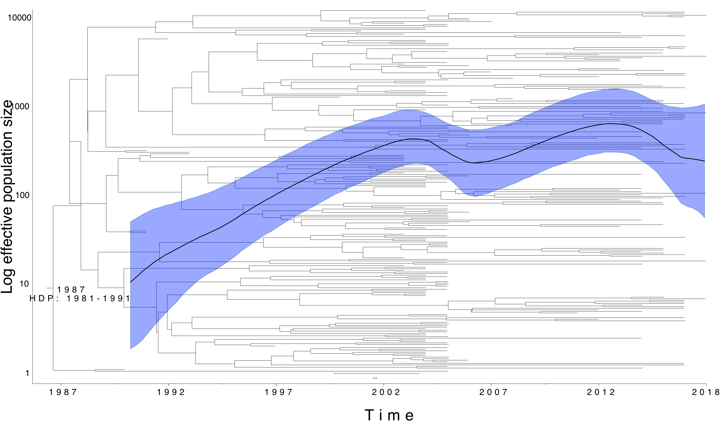
RR-TB cluster present since rifampicin introduced
Ngabonziza et al, JCTUBE, 2022

Slide 29
Transmission more likely in relapse cases
TransPhylo used to estimate secondary case contact rate
  How many peoples does a an infected individual infect?
Primarily those in Category 2 (repeated treatment failures) that transmit this clone
  Clinical management brings down transmission
Ngabonziza et al, JCTUBE, 2022

Slide 30
Estimating epidemic events

Slide 31
Tracking an influenza outbreak
The H1N1 (swine flu) influenza strain was first identified in April 2009
Within a few months it reached pandemic proportions
Phylogeographic analysis
  Where did the outbreak start?
  How and when did it spread?

Slide 32
Tracking an influenza outbreak
Lemey et al (2009), “Reconstructing the initial global spread of a human influenza pandemic” PLOS currents
242 sequences
  HA and NA gene sequences
  40 locations worldwide
  30th March to 12th July 2009
Bayesian framework
  HKY + gamma model
  Relaxed molecular clock
  BSSVS model of spatial diffusion
    Bayesian stochastic search variable selection
    7 discrete locations as priors
    Allow MCMC to assign location probabilities to internal nodes

Slide 33
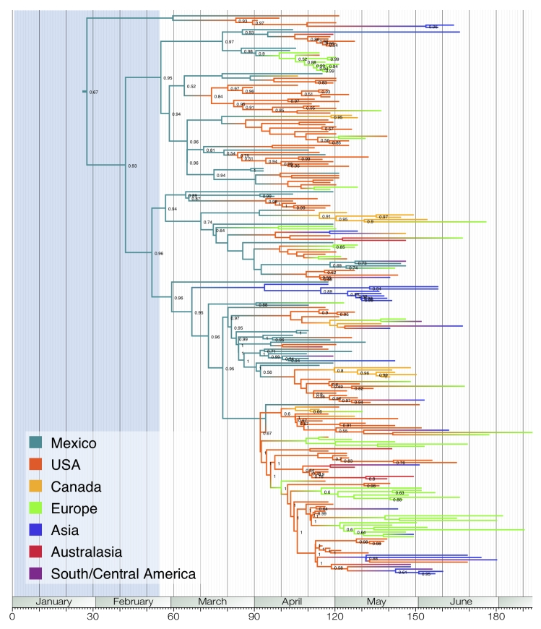
Tracking an influenza outbreak
Phylogenetic reconstruction indicates Mexico as the likely origin of the virus
Several USA strains were seeded early in the outbreak
Most European lineages came from USA strains, not Mexico
Lemey et al (2009). PLoS Curr.

Slide 34
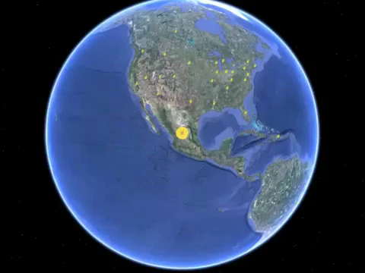
Tracking an influenza outbreak
Lemey et al (2009). PLoS Curr.

Slide 35
Microbial phylodynamics
Origins of a pathogen
  What host did it jump from?
  When did it jump?
Population dynamics
  Population size changes over time
Local transmission
  What is driving local epidemics?
Global spread of epidemics
  Where did it start?
  What were the focal points of transmission?

Slide 36
Tasks 3
What molecular evidence should be gathered to prove zoonitic transmission?
List 3 assumptions that need to be fulfilled to undertake population dynamic analysis
What kind of phylogenetic tree building approach is needed to incorporate location data into the process?

Slide 37
Learning outcomes
Recognise the Monte Carlo Markov Chain process
Describe some common Bayesian epidemiology priors
State the molecular clock hypothesis
Describe the coalescent and its use for estimating population dynamics
Identify the origins of a new pathogen using phylogenetics
Recognise the approaches used to determine transmission dynamics of pathogens

