Slide 1
Microbiome analysis
Conor Meehan (he/they)
conor.meehan@ntu.ac.uk
@con_meehan

Slide 2
Learning outcomes
Explain various terminology and concepts associated with microbiomes
Recognise the three primary diversity measures
Compare and critique various methodologies for microbiome profiling

Slide 3
Microbiome definitions
Berg et al Microbiome 2020

Slide 4
Terminology
Microbiome
Diversity
Range and types of microbes in a microbiome
Metagenome
All DNA in the microbiome
Metabolomics
All the metabolites in the microbiome
Probiotic
Live microbes added to a microbiome for some effect
Prebiotic
Nutrient sources added to a microbiome to promote specific microbial growth

Slide 5
Microbiome: moving research
Berg et al Microbiome 2020

Slide 6
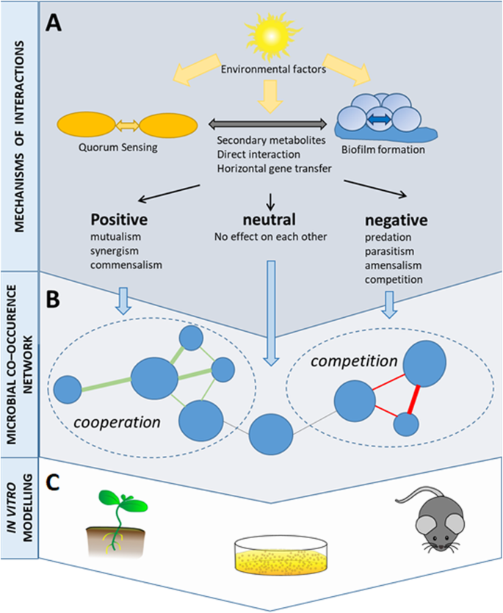
Microbial interactions
Berg et al Microbiome 2020

Slide 7
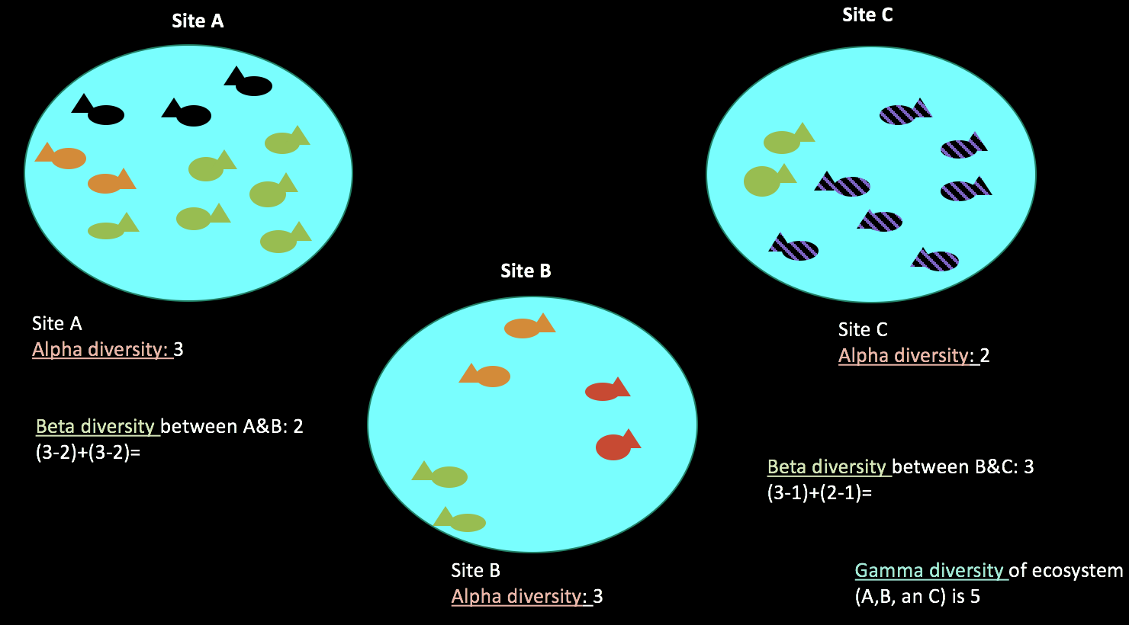
Microbial diversity
https://awbrooks19.github.io/vmi_microbiome_bootcamp/rst/4_concepts_of_community_analysis.html

Slide 8
Diversity measures
Alpha diversity
The amount of diversity observed in a sample
E.g. Shannon diversity
Beta diversity
Measure of similarity (or dissimilarity) between 2 samples
E.g. Bray-Curtis measure
Can be informed by phylogeny
Gamma diversity
Total diversity in a given set of samples

Slide 9
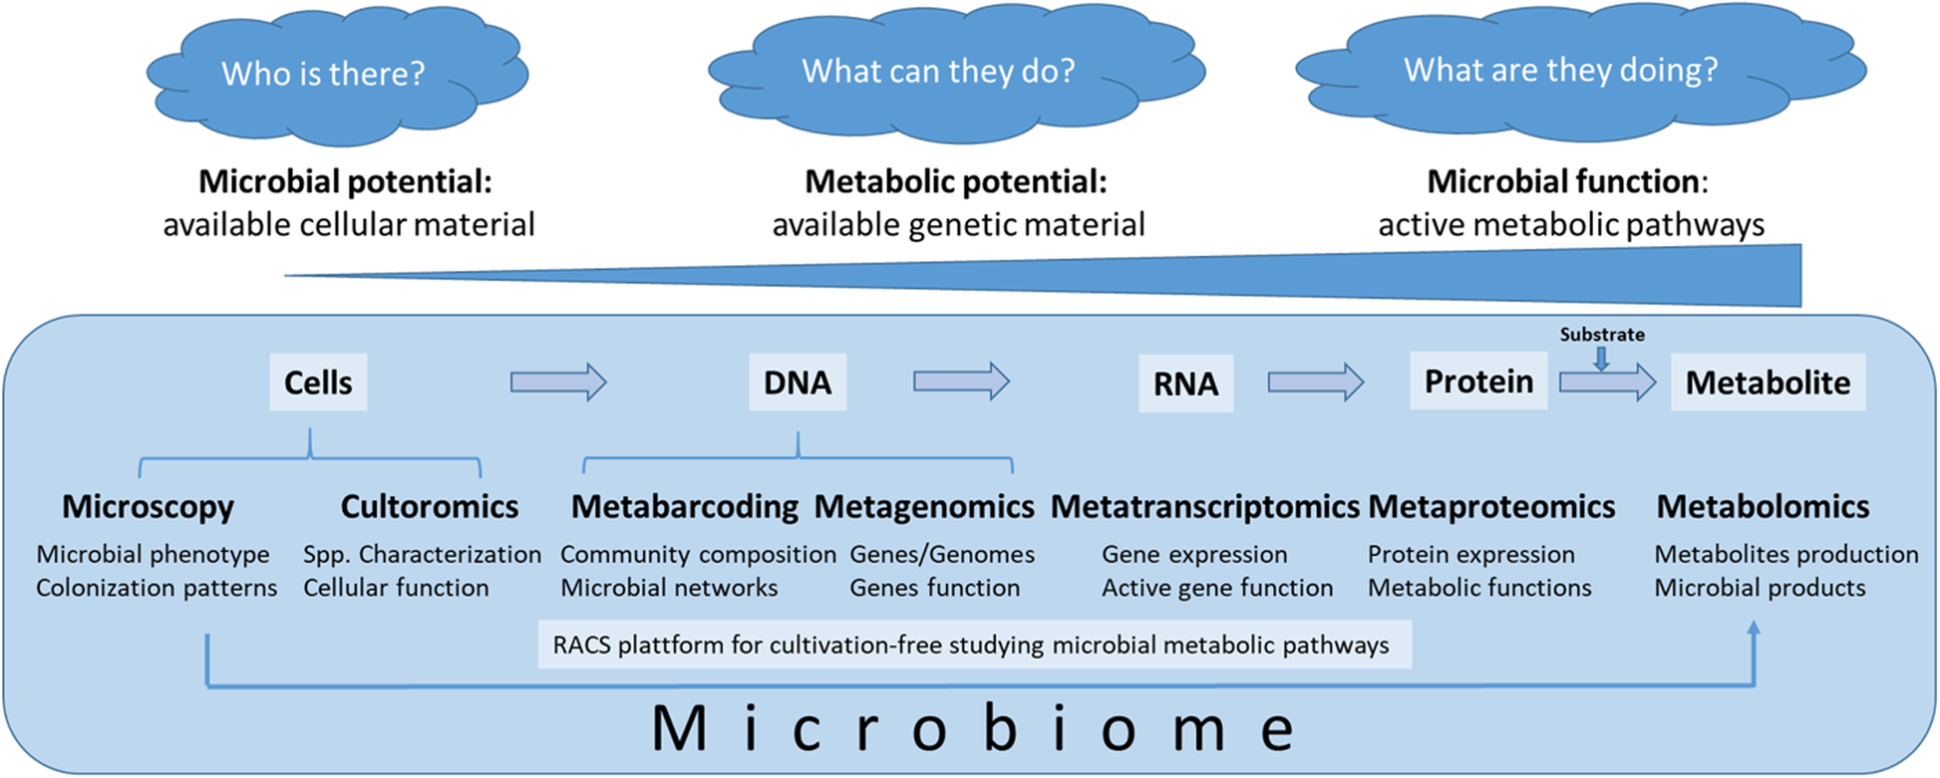
Microbiome profiling
Berg et al Microbiome 2020

Slide 10
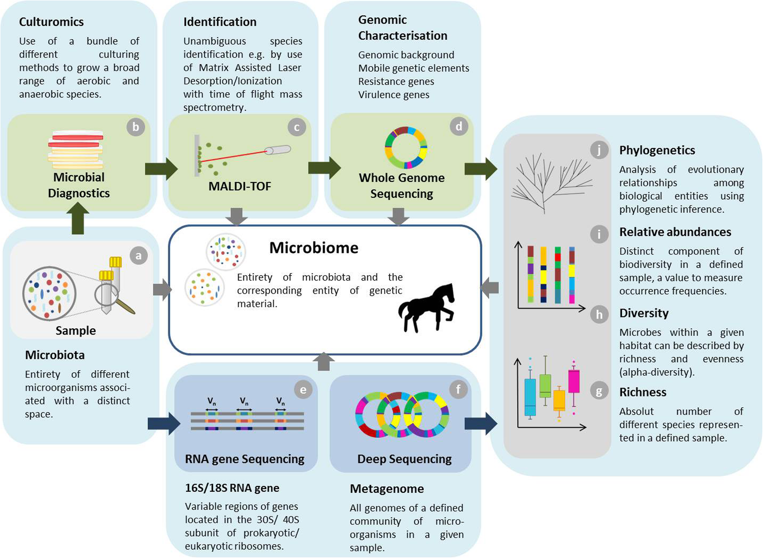
Microbiome profiling
Kauter et al Animal Microbiome 2019

Slide 11
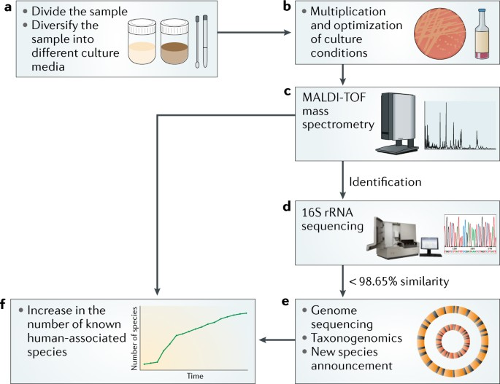
Culturomics
Lagier et al Nat Rev Micro 2018

Slide 12
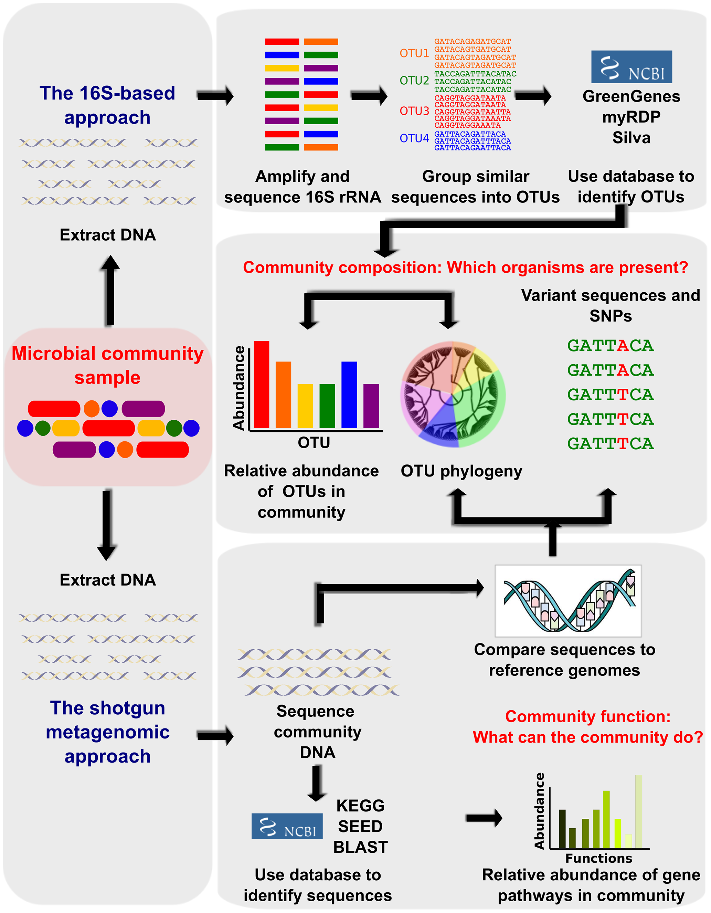
Metabarcoding
Also called amplicon sequencing
Portion of 16S rRNA gene used for taxonomic identification
Difficult to distinguish below species level
Programs:
QIIME2
Mothur
PhyloSeq (post-mapping analyses in R)
https://journals.plos.org/ploscompbiol/article/figure?id=10.1371/journal.pcbi.1002808.g001

Slide 13
Which 16S region?
Only variable regions chosen
Different regions, different bacteria captured
3rd generation sequencing allows for whole 16S
Better resolution
Less depth (for now)
Walker et al Sci Rep 2020

Slide 14
Which 16S database?
3 primary 16S rRNA gene reference databases:
GreenGenes2 (GG2)
Superseded GreenGenes (GG)
Can do to species level (supposedly)
Currently seems to be preferred option (but not implemented in all tools)
Silva
Quite complete
Species-level no longer being curated
RDP
Only goes to genus level
Most tools can have the database changed to your preference
Need to ensure trained on same classifier you use

Slide 15
No tool/database is perfect
Amplicon differences
Database differences
Note this is GG not GG2
Read this (and other benchmark papers): https://journals.asm.org/doi/10.1128/msphere.01202-20

Slide 16
Metagenomics
Sequence all DNA in the sample
Tools (non-exhaustive list)
Assembly
MEGAHIT
metaSPAdes
Direct taxonomic classification
Kraken2
Centrifuge
Require a lot of computational resources
Kraken2 needs 36Gb of RAM
https://journals.plos.org/ploscompbiol/article/figure?id=10.1371/journal.pcbi.1002808.g001

Slide 17
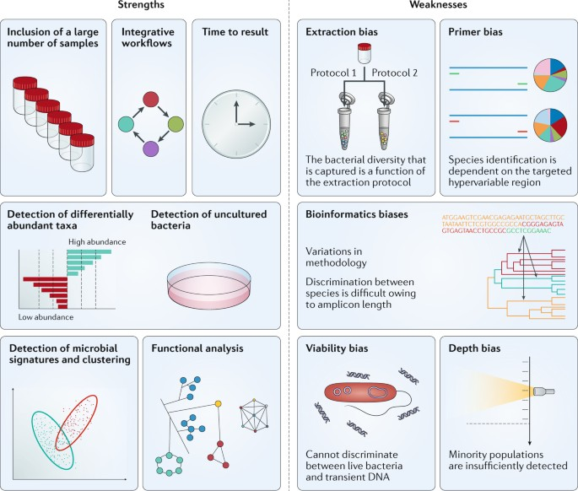
Metagenomics
Lagier et al Nat Rev Micro 2018

Slide 18
Microbiome profiling
Kauter et al Animal Microbiome 2019

Slide 19
Microbiome profiling
Kauter et al Animal Microbiome 2019

Slide 20
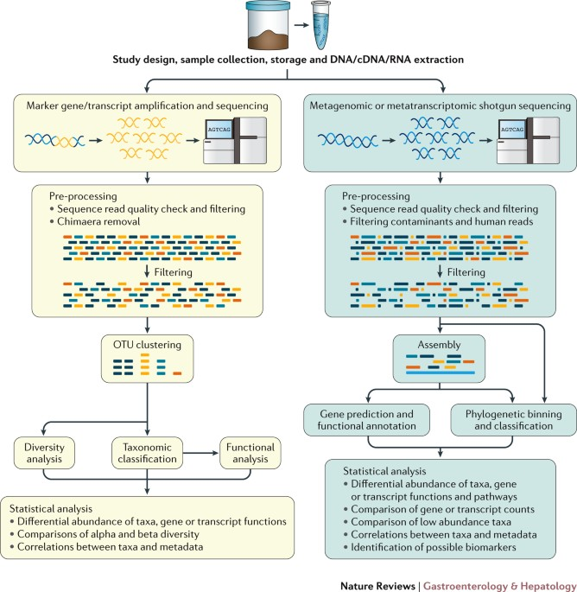
Amplicon vs metagenomic analyses
Claesson et al Nat Rev G&H 2017

Slide 21
Tools for analyses
Growing field
Lots of new things, lots of mistakes
Lots of tools to do different things
Most UNIX- or R-based
Often require a lot of computational resources
Carefully read benchmarking papers and test workflows

Slide 22
Learning outcomes
Explain various terminology and concepts associated with microbiomes
Recognise the three primary diversity measures
Compare and critique various methodologies for microbiome profiling

