Slide 1


What’s in a name?
Bacterial nomenclature bioinformatics workshop
Conor Meehan (He/They)
conor.meehan@ntu.ac.uk
@con_meehan

Slide 2
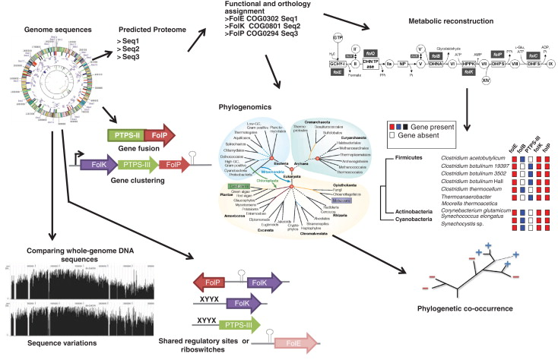
Comparative genomics
Delsuc et al Nat Rev Gen 2005

Slide 3
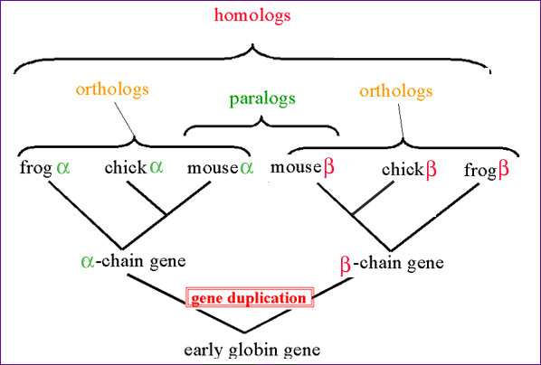
Homologs
Two genes are said to be homologs if they share an ancestor
3 types:
  Ortholog
  Paralog
  Xenolog
http://www.discoveryandinnovation.com/bioinformatics/glossary_detail/homolog.html

Slide 4
Defining a genus

Slide 5
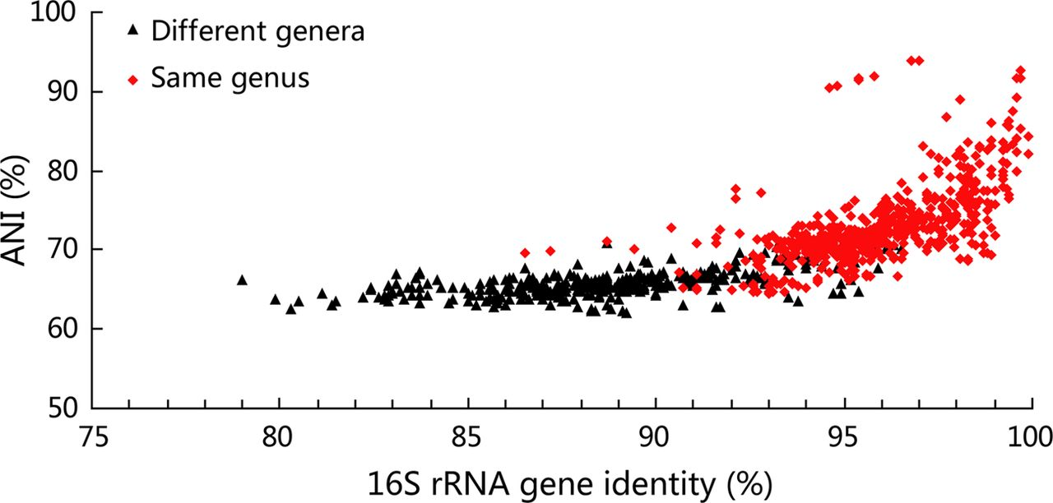
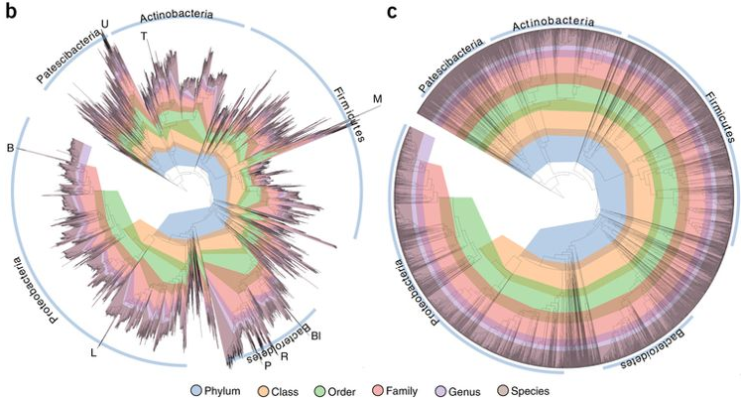
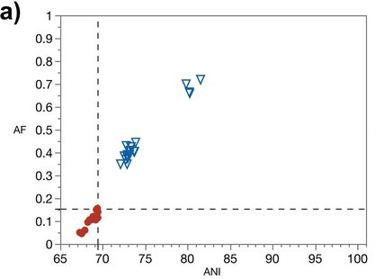
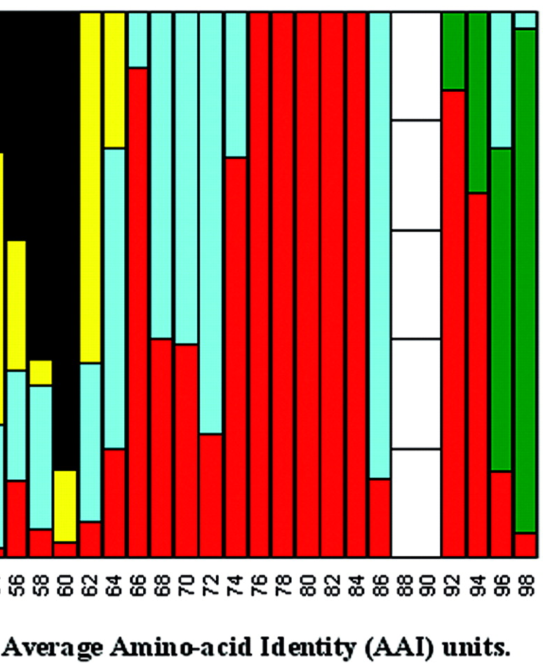
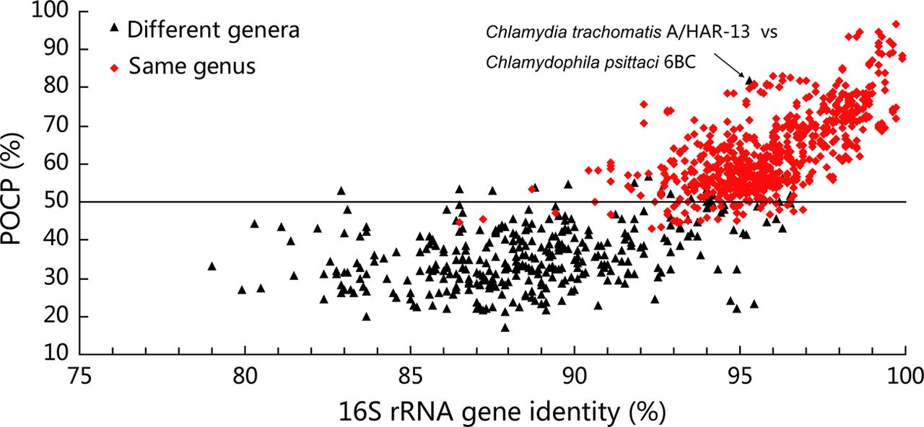
Defining a genus
Qin et al (2014); J. Bact
Parks et al (2018); Nature Biotech
Barco et al (2020); MBio
Konstantinidis et al (2005); J. Bact
Qin et al (2014); J. Bact
Species
Genus
Family

Slide 6
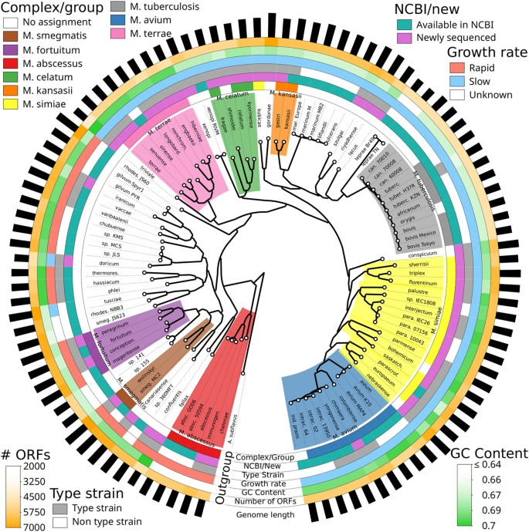
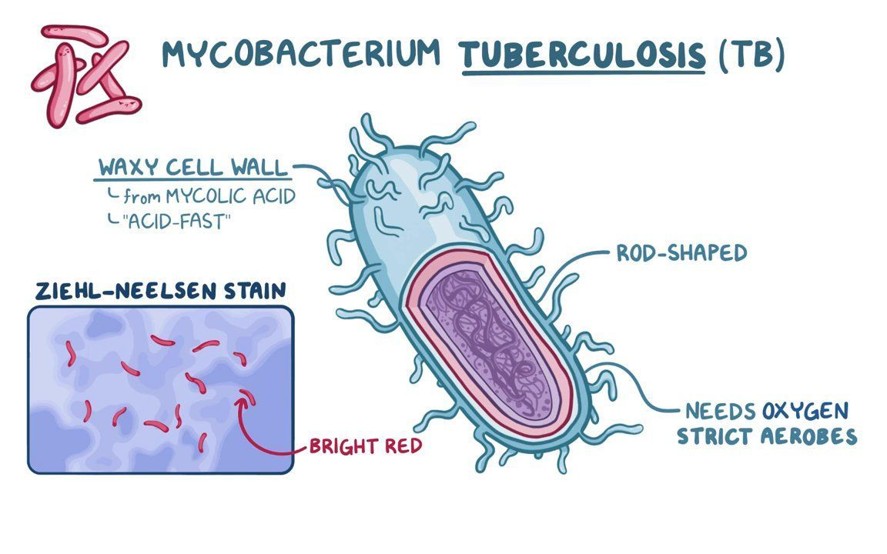
Mycobacterium genus
https://www.osmosis.org/learn/Mycobacterium_tuberculosis_(Tuberculosis)
Fedrizzi, Meehan et al (2017); SciRep

Slide 7
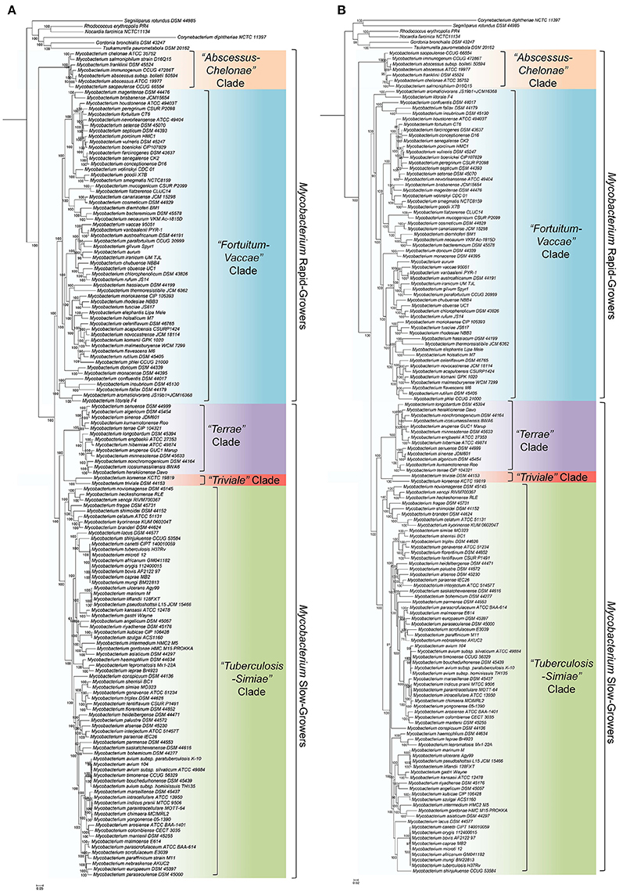
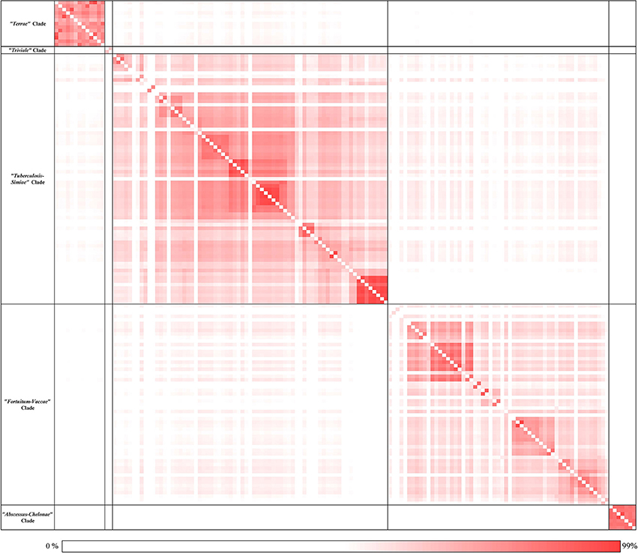
Splitting into 5 genera
Mycobacteroides
Mycolicibacterium
Mycolicibacter
Mycolicibacillus
Mycobacterium
AAI
ML trees
Gupta et al (2018); Front Microbiol

Slide 8
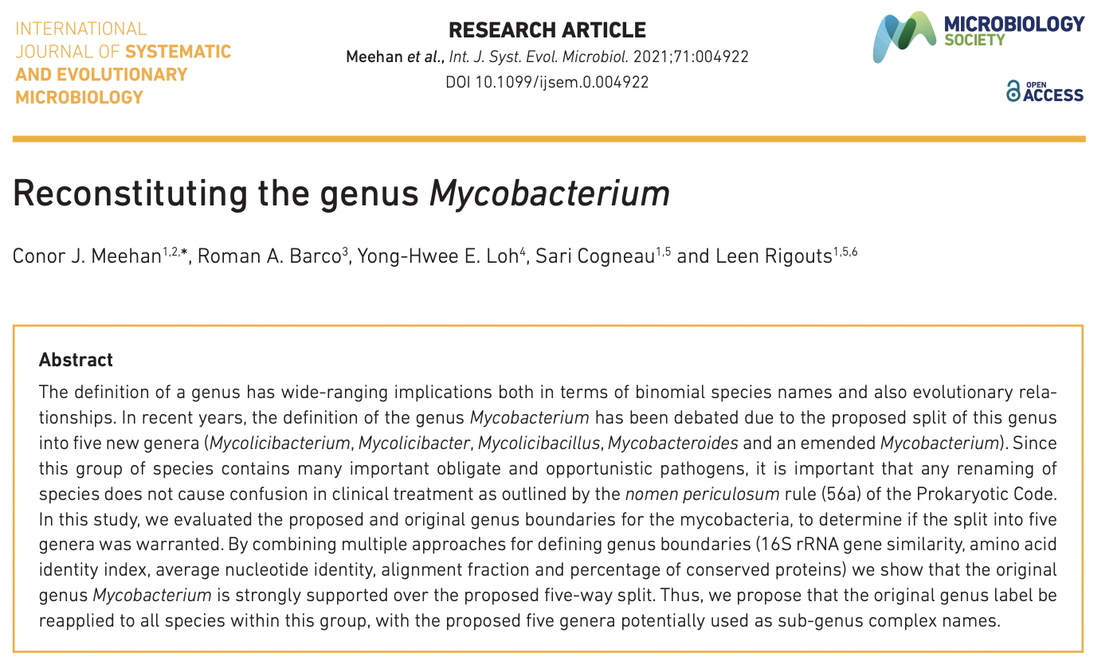

Slide 9
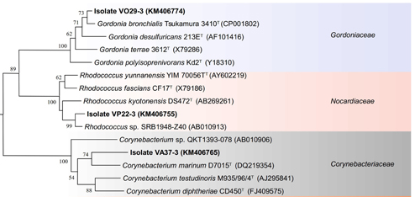
Genomic dataset
137 Mycobacterium
210 Corynebacteriaceae
Paz et al (2015); Front Microbiol
Fedrizzi, Meehan et al (2017); SciRep

Slide 10
16S and AAI
(a) Mycobacterium (original)
(b) Mycobacterium (Gupta)
(c) Mycobacteroides
(d) Mycolicibacillus
(e) Mycolicibacter
(f) Mycolicibacterium
Red: intra-genus comparison
Black: inter-genus comparison
Meehan et al (2021); IJSEM

Slide 11
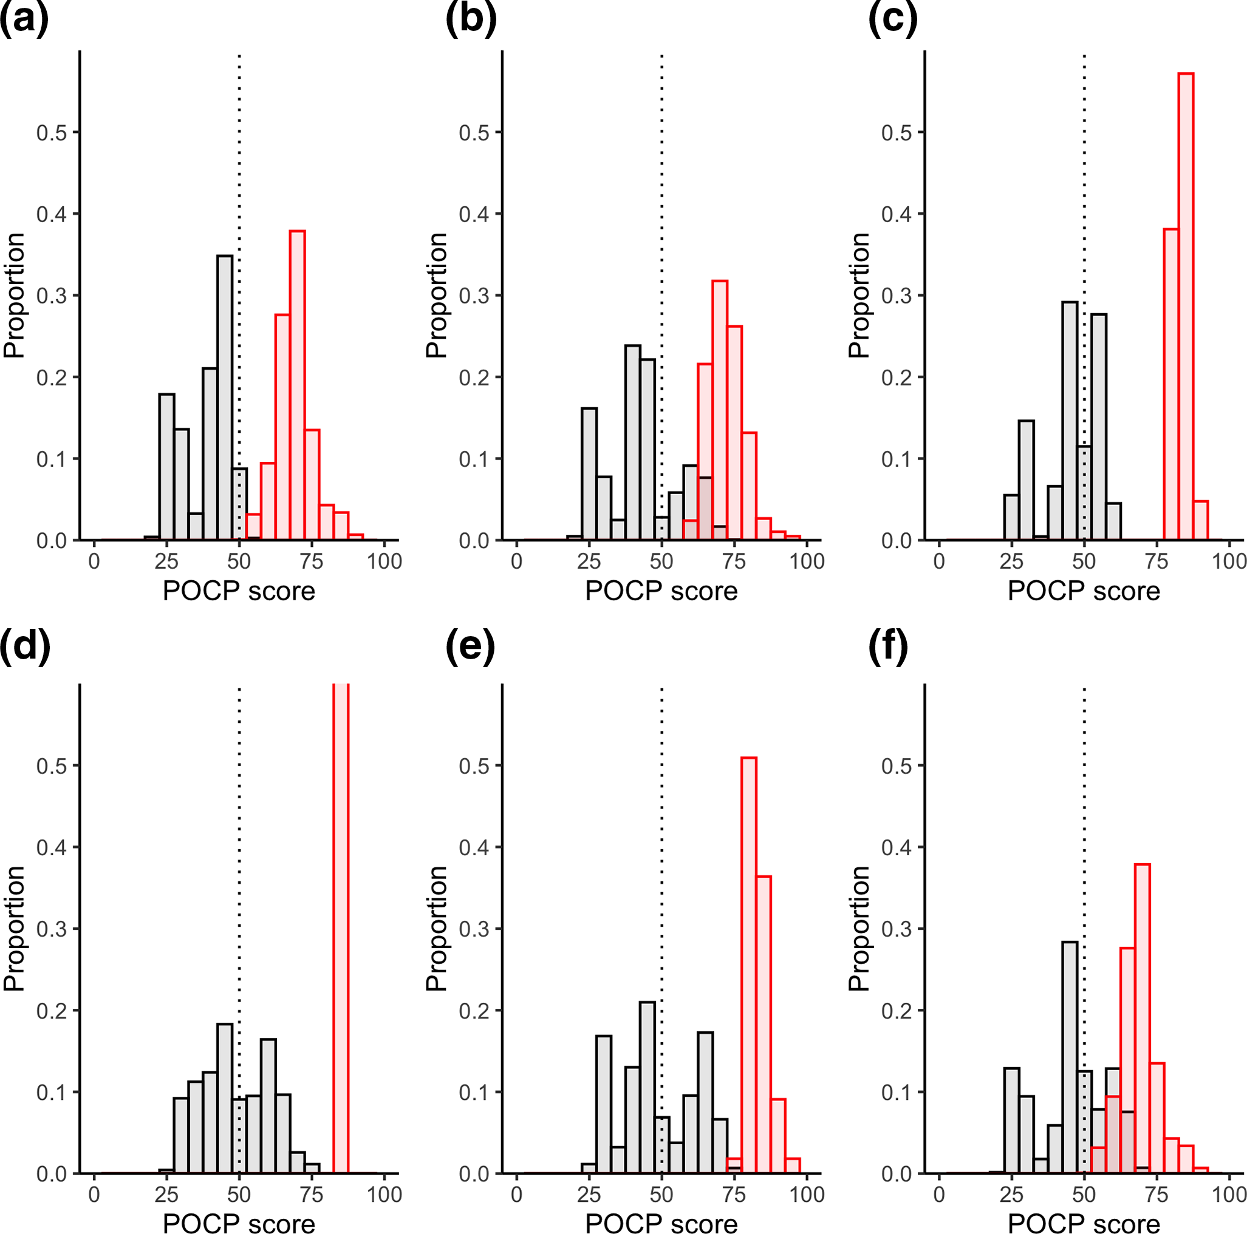
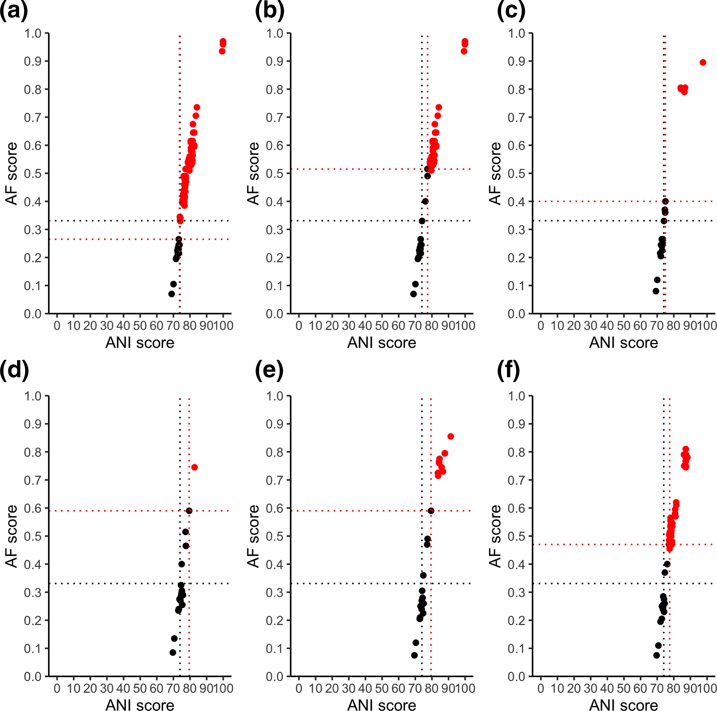
POCP and AF/ANI
(a) Mycobacterium (original)
(b) Mycobacterium (Gupta)
(c) Mycobacteroides
(d) Mycolicibacillus
(e) Mycolicibacter
(f) Mycolicibacterium
Red: intra-genus comparison
Black: inter-genus comparison
Meehan et al (2021); IJSEM

Slide 12
Mycobacterium: single genus
Fedrizzi, Meehan et al (2017); SciRep
Gupta et al (2018); Front Microbiol

Slide 13
Defining a species

Slide 14
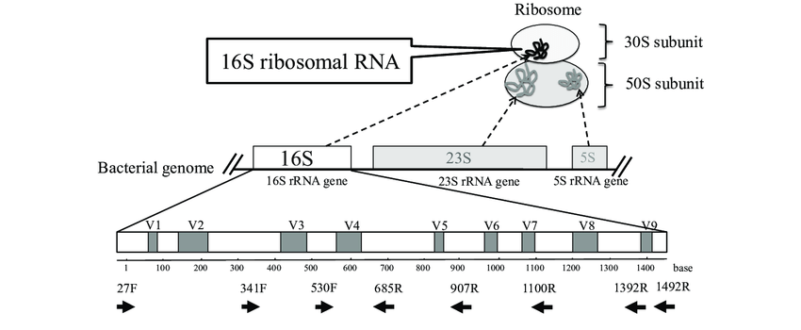
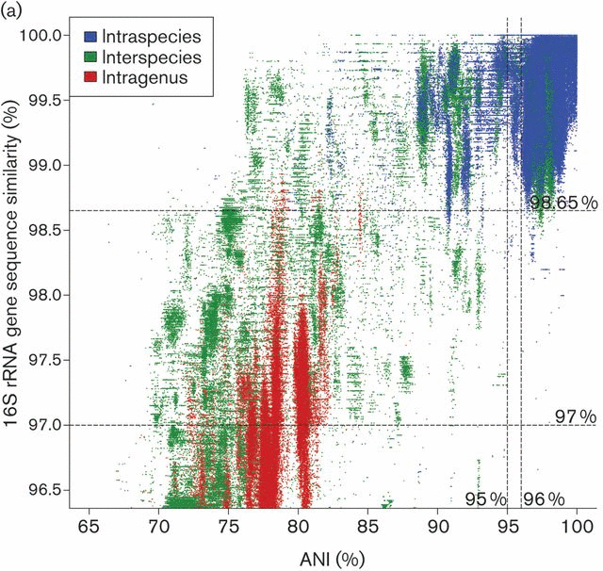
16S rRNA gene
Core gene for prokaryotic taxonomy
  Sequence similarity
Compare whole gene sequences
  >98% similar
    Same species
Difficulties for species with large pangenomes
Kim et al IJSEM 2014
Fukuda et al JUOEH 2016

Slide 15
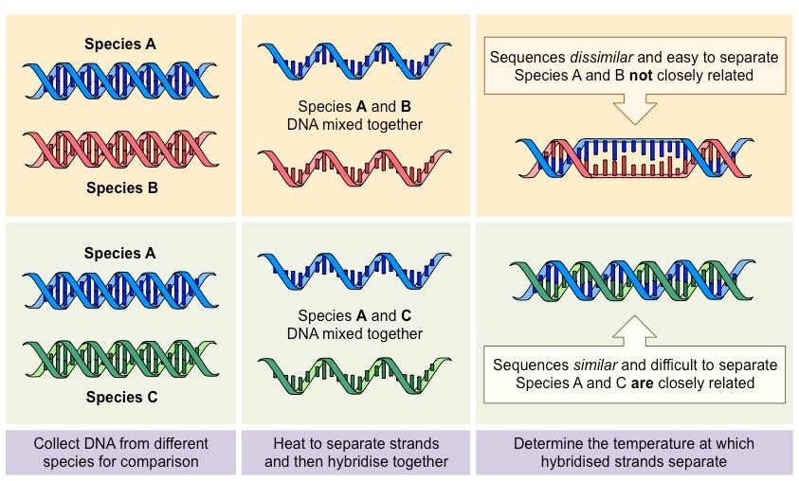
DNA:DNA Hybridisation (DDH)
DNA similarity of 70%
  5°C melting
  Same species
DNA similarity of 79%:
  Same subspecies
Build phylogenies from distance matrices
Paralogs cause issues
https://ib.bioninja.com.au/standard-level/topic-5-evolution-and-biodi/54-cladistics/in-situ-hybridisation.html

Slide 16
Species typing: dDDH
In silico version of DDH
Comparison of genomes X and Y using BLAST
  Find orthologous stretches of DNA
    High-scoring segments pair (HSPs)
Calculate how much of genome X and Y are covered by HSPs
dDDH coverage formula:
Implemented in TYGS webserver
Henz et al Bioinformatics 2004

Slide 17
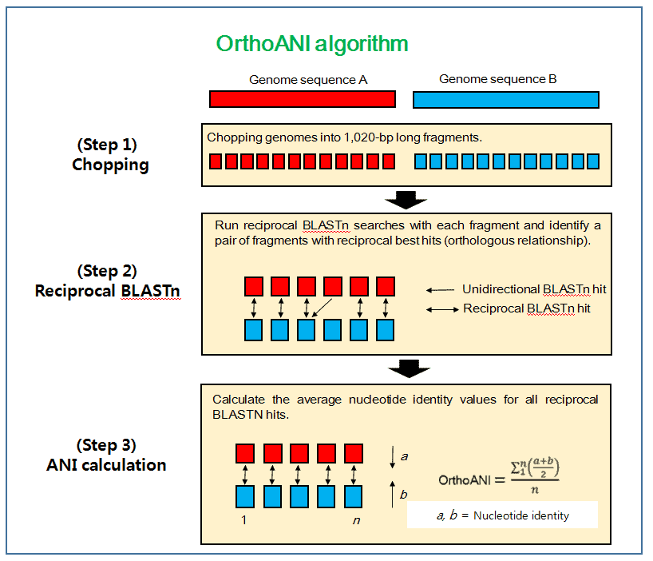
Species typing: ANI
Average nucleotide diversity
Find all the homologous (shared) sections of two genomes
How many nucleotides are identical in those shared sections?
Divide by the length of the shared sections of DNA
    This is the ANI
https://link.springer.com/protocol/10.1007/978-1-60327-999-4_10

Slide 18
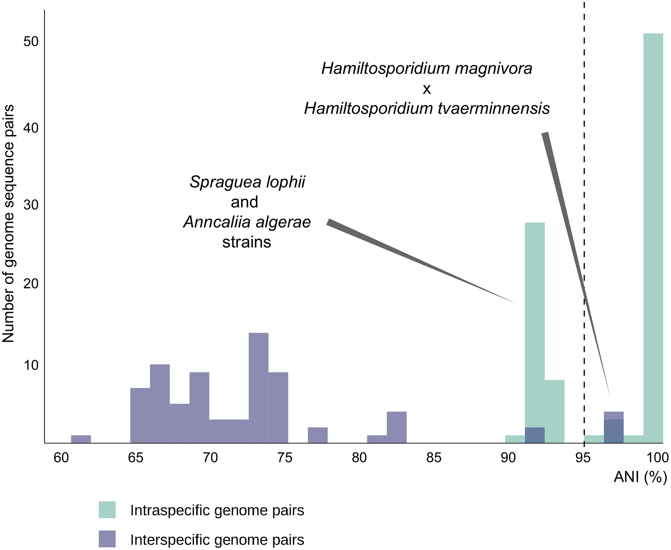
Species typing: ANI
ANI ≥ 95%:
  Same species
  Often make exceptions for clinical characteristics
ANI ≥ 98%:
  Same subspecies
  Not a standard cut-off
Programs:
  fastANI
  OrthoANI
Albuquerque & Haag, Euk Micro 2022

Slide 19
Defining within a species

Slide 20
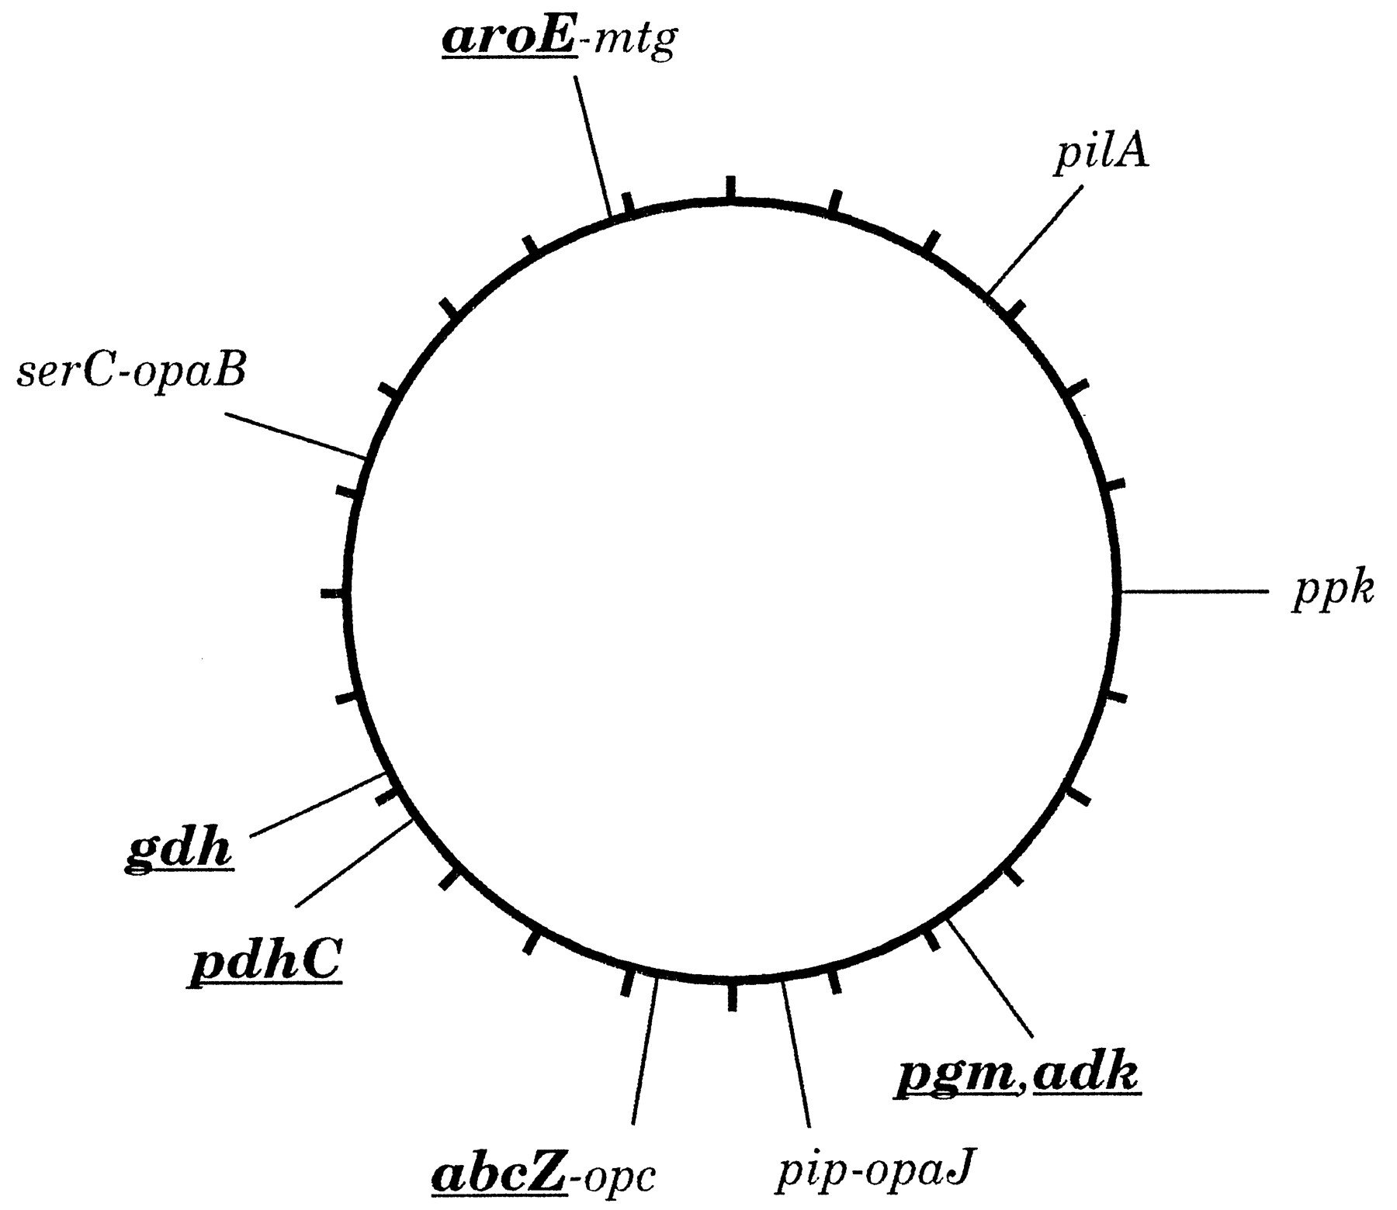
MLST
Multi-locus sequence typing
Used to define groups within a species
A set of housekeeping (universal genes) is selected for the species
  Usually 7-10 genes
Maiden et al PNAS 1998

Slide 21
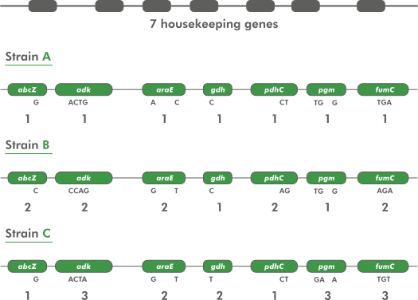
MLST assignment
Alleles are assigned a type code based on unique sequences across all genes in the scheme
  Often SNPs in each gene
Query sequences are assigned to allele types if they match the sequence of that allele
https://www.applied-maths.com/applications/mlst

Slide 22
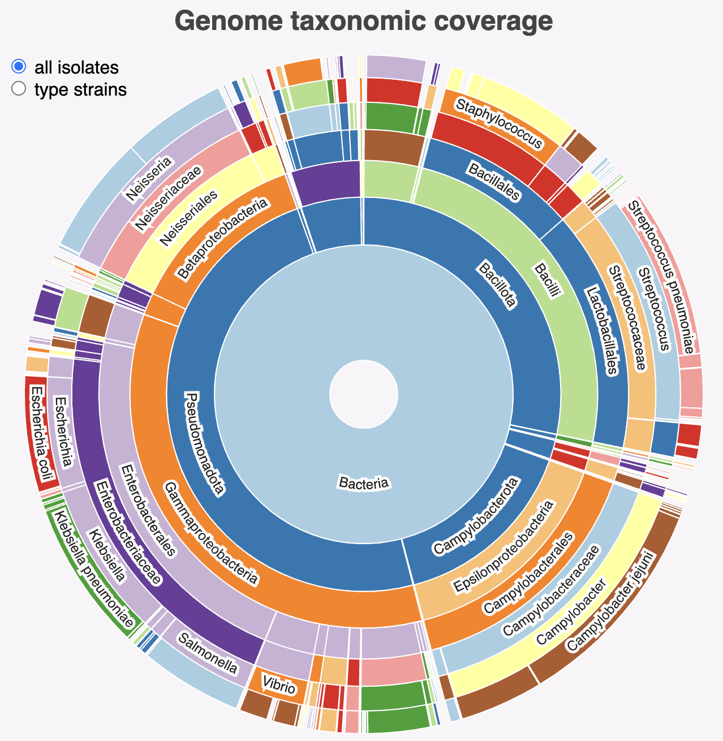
MLST schemes
Schemes exist for many common bacterial species
PubMLST contains most schemes
  135 organisms included
  Can create your own and include if not present
  https://pubmlst.org/mlst
MLST tool will scan contigs against these schemes and type your sample
  https://github.com/tseemann/mlst
https://pubmlst.org/species-id

Slide 23
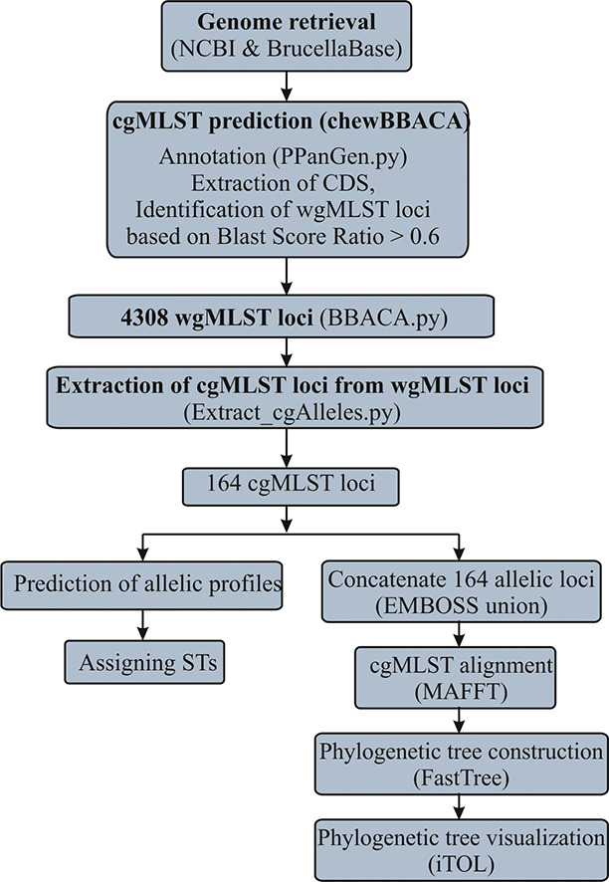
cgMLST
MLST relies on a few genes to type a sample
  May not be enough signal
  Doesn’t work for very monomorphic species
Can create an expanded MLST using all genes shared by all strains within a species
  Tends to be hundreds or even thousands
  Core genome MLST (cgMLST)
https://www.cgmlst.org/ncs contains many cgMLST schemes
  Can create own with tools like chewBBACA
Sankarasubramanian et al IGE, 2019

Slide 24
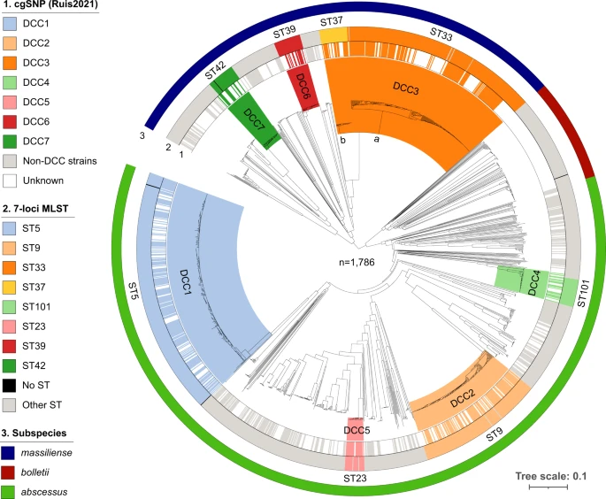
cgMLST for defining strains
MLST will split species/subspecies into a few groups
  Not informative enough for local clustering
  Useful for tracking circulating types as doesn’t not over split data
cgMLST will split MLST into more granular groups
  Good for tracking bacteria with variable genomes
  May not find specific transmission cluster
Diricks et al Nat Comm 2022

Slide 25
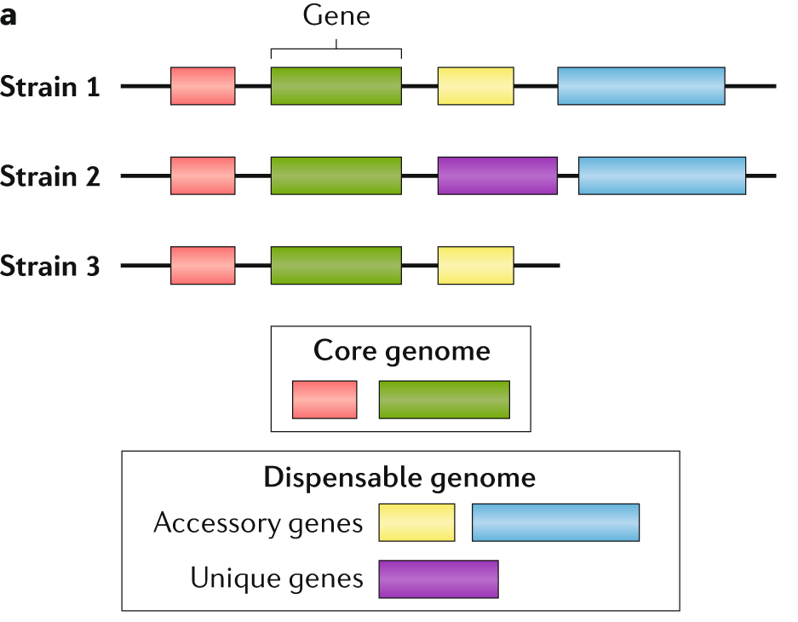
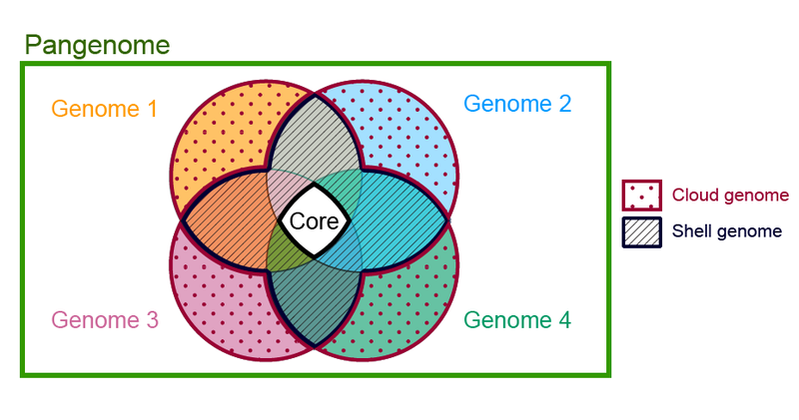
Pangenome
Wikipedia
Sherman & Salzberg Nat Rev Genetics 2020

Slide 26
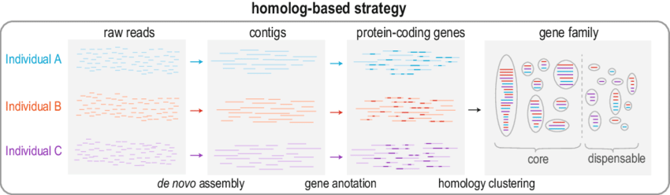
Pangenome construction
Many approaches but homology strategy is common
Example programs:
  Panaroo, Roary, Pagoo etc.
Sensitive to inputs (e.g. genome assembly quality) and settings (e.g. cut-offs)
Hu et al The Pangenome 2020

Slide 27
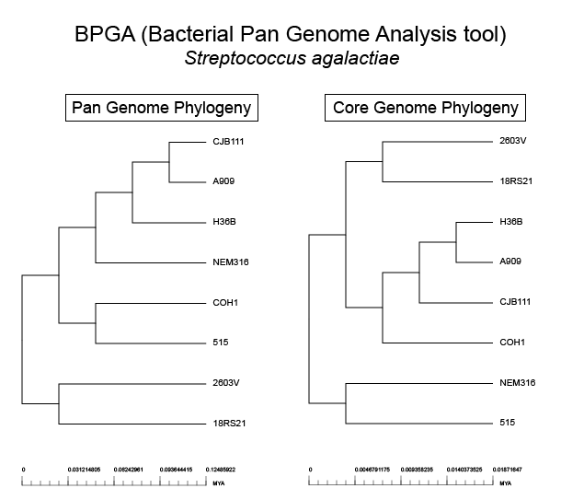
Pangenome phylogenetics
Usually use core genes to create a super-alignment
  A concatenated alignment of individual gene alignments
  Usually excludes intergenic regions
Can use full pangenome data
  Messy if open pangenome
Recombination removal run on this core alignment
  Ensures vertical inheritance signal only
Build phylogenetic tree
  RAxML, IQ-TREE, BEAST etc.
Wikipedia

Slide 28
Questions?
https://conmeehan.github.io/NomenclatureWorkshop/NomenclatureWorkshop.html

